Slide 1
Presentation for the NSC Labor Division
Friday, Sept 12, 2014, 3 pm - 4:30 pm PDT
2014 National Safety Council Congress and Expo
San Diego, California
Nanotechnology Challenges and Opportunities for Safety, Health, Well-being, and Productivity
in the Workplace
Mark D. Hoover, PhD, CHP, CIH (mhoover1@cdc.gov)
NIOSH, Morgantown, WV
Charles L. Geraci, PhD, CIH (cgeraci@cdc.gov) NIOSH, Cincinnati, OH
Bruce Lippy, PhD, CIH, CSP (blippy@cpwr.com) CPWR, Silver Spring, MD
The findings and conclusions in this presentation are those of the authors
and do not necessarily represent the views of their respective organizations.
Mention of company names or products does not constitute endorsement.

Slide 2
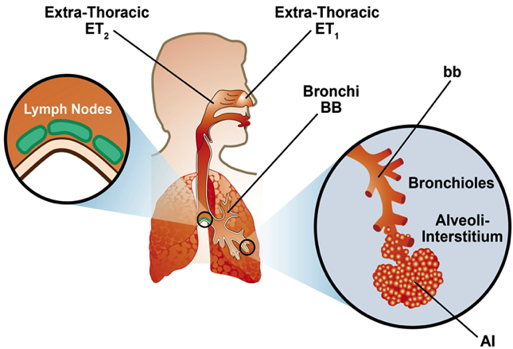
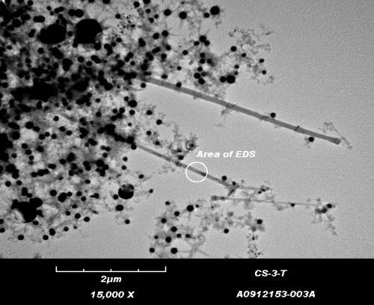
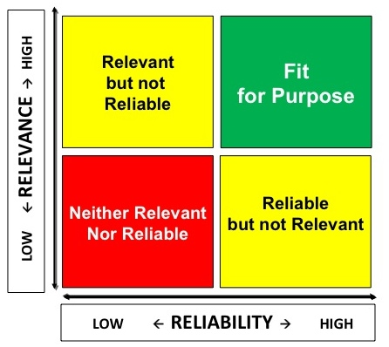
What is the context for the NSC Labor Division?
Safety, Health,
Well-being, and
Productivity
*
Emerging
Technology
Risk Management
Adapted from L. J. Cash (2014)

Slide 3





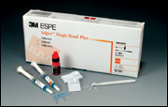

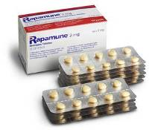
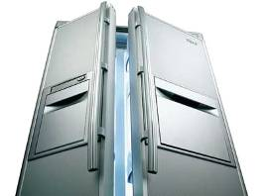











Nano-enabled products are on the market
Mercedes CLS-class
Wilson Double Core tennis balls
Eddie Bauer Ruston Fit Nano-Care khakis
3M Adper Single Bond Plus dental adhesive
Wyeth Rapamune immuno-suppressant
Smith & Nephew Acticoat 7 antimicrobial wound dressing
Samsung Nano
SilverSeal Refrigerator
Laufen Gallery washbasin with Wondergliss
Kodak EasyShare LS633 camera
Hummer H2
NanoOpto subwavelength
polarizing beam splitter/combiner
Gibbs, 2006

Slide 4
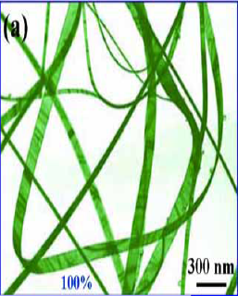
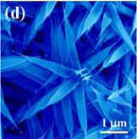
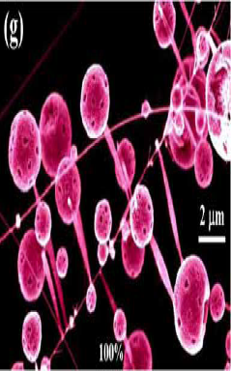
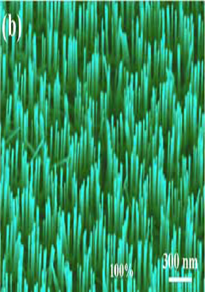
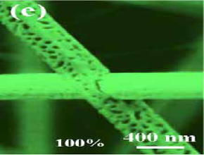
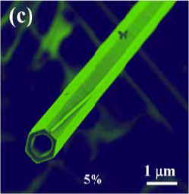
Diversity Example: Zinc Oxide Nanomaterials
Photos: Dr. Z Wang, Georgia Tech

Slide 5
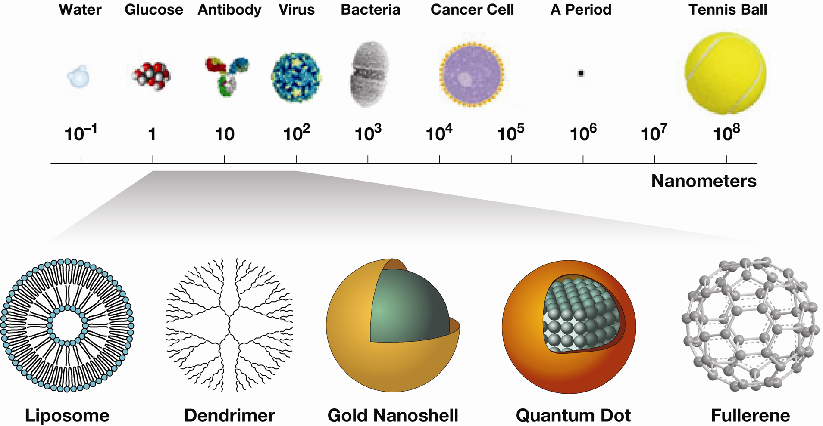
A range of particle sizes, shapes, and types
Human Cell
National Cancer Institute
Notes:
Bacteria can be a large as 6 um (e.g. E. coli can be that long, although some can be as huge as 600 um) and as small as 100 nm (Mycoplasma). Nanochlorum eukaryotum is the smallest eukaryote with size about 1 um. Eukaryotic cells range between 1 and 100 um (red blood cell is about 7 um). Average viruses are 10 to 300 nm (filovirus up to 1400 nm in length, mimivirus up to 400 nm in diameter). Size of botulinum toxin type c is 7.4 nm

Slide 6

The definition of nanotechnology includes all three of these features
Research and technology development at the atomic, molecular, or macromolecular levels, in the length scale of approximately 1-100 nm.
Creating and using structures, devices, and systems that have novel properties and functions because of their small and/or intermediate size.
Ability to control or manipulate on the atomic scale.
www.nano.gov
Notes:
First of all I would like to define nanotechnology. The NNI definition includes three features: nanoscale, unique properties and engineered. Since information about behavior of nanoscale particles can provide with information about engineered particles in my talk I will include description of research that NIOSH conducts about ultrafine particulate.

Slide 7
The National Institute for Occupational Safety and Health is:
  the U.S. Federal agency responsible for
  conducting research and making recommendations for the prevention of work-related illness, injury, disability, and death.
www.cdc.gov/niosh

Slide 8


























We participate in the National Nanotechnology Initiative (NNI)
www.nano.gov

Slide 9


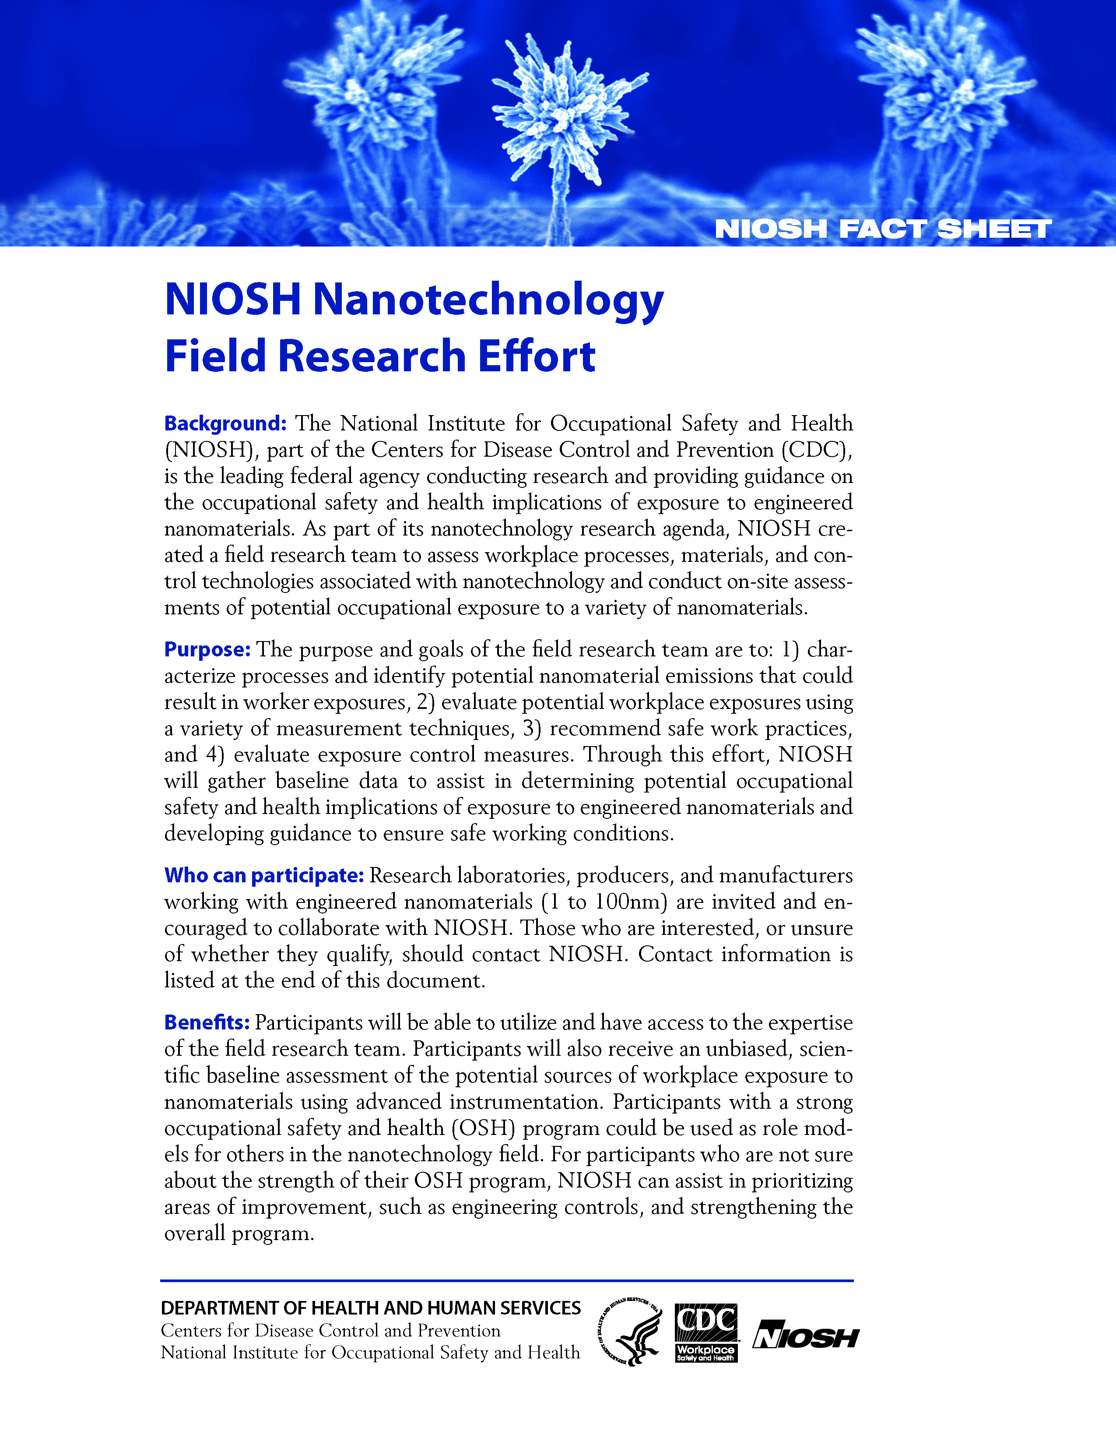

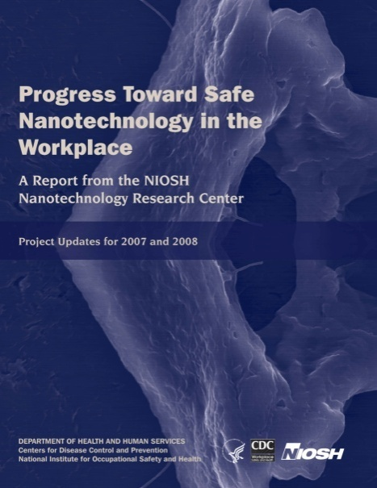
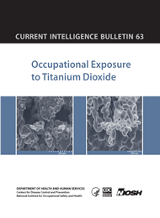






Key guidance is available from NIOSH
Key guidance is available from NIOSH
English
Spanish
Portuguese
Italian
Japanese
www.cdc.gov/niosh/topics/nanotech
9

Slide 10
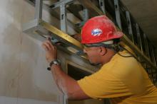
Some background about CPWR
The Center for Construction Research and Training
Our Mission is:
To encourage the elimination or reduction of conditions constituting hazards to the safety or health of U.S. construction workers, and to promote the maintenance and improvement of safe and healthy working conditions for workers in the construction industry.
www.cpwr.com

Slide 11

CPWR provides resources in many areas and we are adding a construction nanomaterial inventory
Notes:
You will be able to search this by application, by nano-object, by company

Slide 12
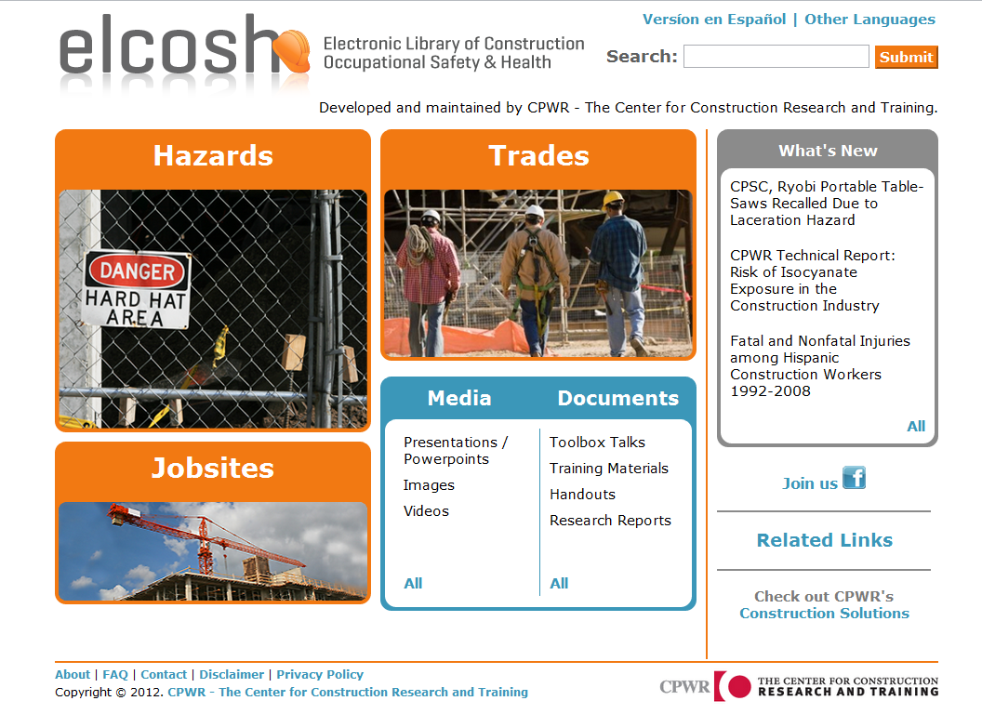
eLCOSH is a repository of construction H&S information
Notes:
Trainer Notes:
Highlight that this is the new look. It is still organized broadly by hazards, trades, jobsites, media, documents and what’s new, but now they are boldly displayed for ease of searching.

Slide 13
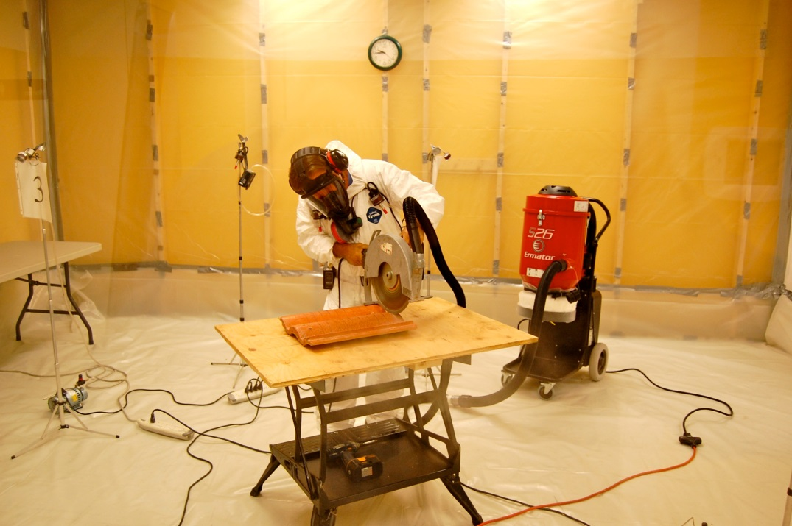
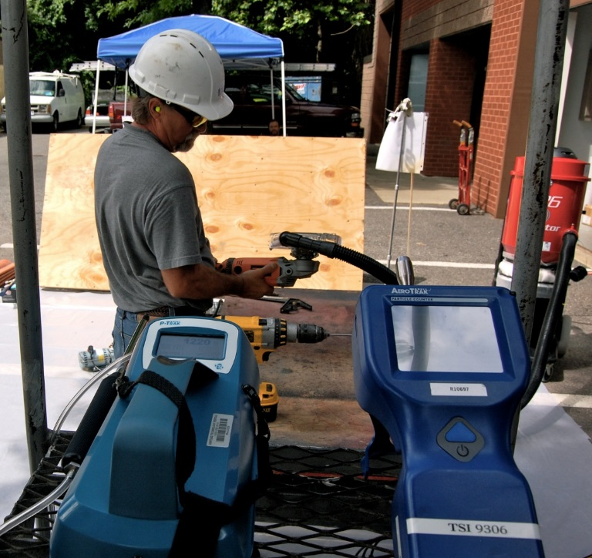
Special thanks to the CPWR Nanotechnology Research Team
Gavin West, CPWR statistician
Dr. Dan Marsick and Mike Cooper, CIHs
Leonard Burrelli and EPI staff

Slide 14
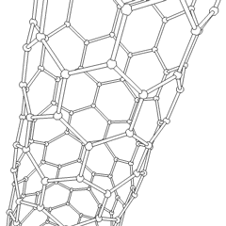

Some concrete examples of challenges and opportunities
Nanotechnology in Construction
Bruce Lippy, Ph.D., CIH, CSP
Director of Safety Research, CPWR
blippy@cpwr.com
Notes:
Trainer Notes

Slide 15
At the end of this session, you will be able to:
Describe the improvements nano-enabled products will bring to construction
Explain why the uniqueness of construction poses additional risks to trades workers
Describe the specific health concerns posed by nanoparticles in construction
Discuss current findings on construction sampling including results from CPWR’s initial test
Apply the hierarchy of controls to nanomaterials and explain what we know about controls
Describe the current state of hazard communication for nano in construction
List several resources that might be useful
1
2
3
4
5
6
7

Slide 16
Describe the improvements nano-enabled products will bring to construction
1
Objective 1

Slide 17
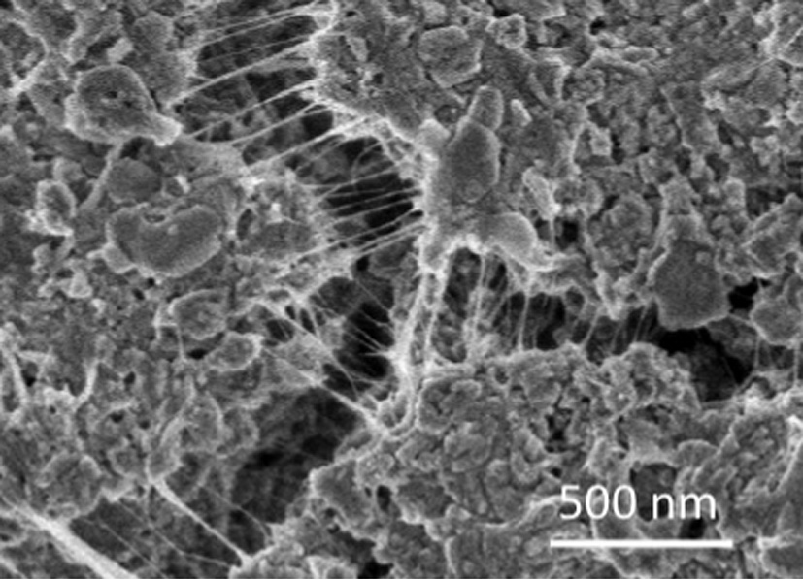
Carbon nanotubes reinforce cement at the nano scale
CNTs bridging a gaps in OPC
Hanus and Harris, 2013
Notes:
From Hanus and Harris (2013): “CNTs have a high tensile strength and Young’s modulus, display elastic behaviour [31] and excellent thermal properties [32]. Indeed, the tensile strength and
Young’s modulus of CNTs are hundreds and tens of times that of steel, respectively, although their weight per volume of CNTs is a mere fraction that of steel. CNTs reinforce concrete at the nanoscale rather than the macro scale in the manner of traditional steel reinforcement bars.”

Slide 18

BASF product speeds up concrete hardening at low temperatures and double strength
Calcium silicate hydrate crystals
Notes:
From BASF: “It helps to speed up concrete hardening significantly at early ages (6-12 hours), supporting at least double strength at low, ambient and heat curing temperatures. X-SEED® 100 consists of synthetically produced crystal seeds in liquid form…. From nanowerk webiste (see other data sources): X-SEED 100 is an engineered suspension of crystal seeds containing nanoparticles, designed to boost the hydration process of early age cement (6-12 hrs). Based on unique and innovative seeding technology, the growth of the essential Calcium Silicate Hydrate crystals is strongly accelerated.”

Slide 19
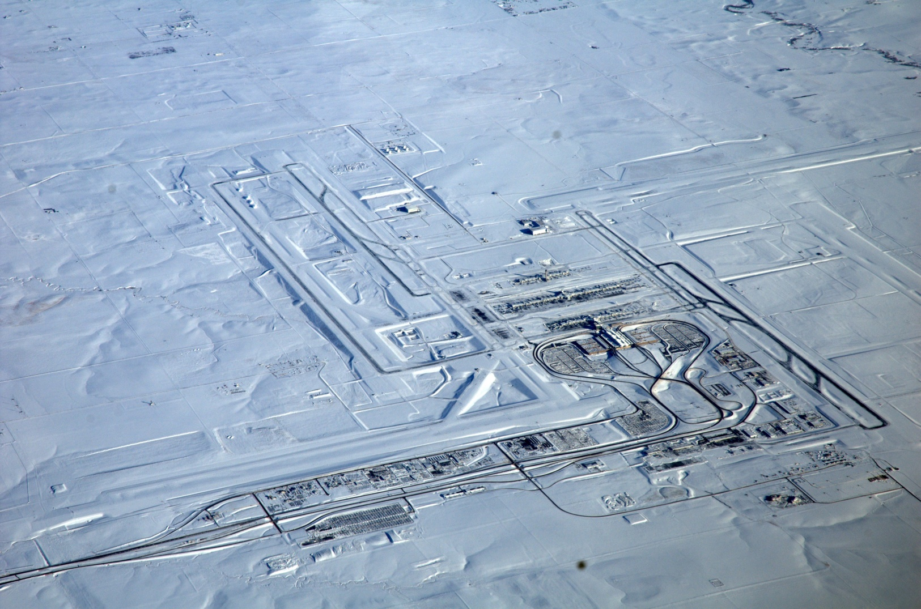
CNTs added to cement could heat airport runways
Denver Airport, Dec 2006
Photo courtesy Wikimedia and Ashley Niblock
Notes:
Researchers at the University of Alicante have developed a cementitious material incorporating carbon nanofibers in its composition, turning cement into an excellent conductor of electricity capable of performing functions beyond its usual structural function.
This new technology, developed and patented by the UA Civil Engineering Department's Research Group in Multifunctional Concrete Conductors, allows, among other functions, the material to heat up due to the passage of current.
"The technology allows buildings' premises to heat or prevents the formation of ice on infrastructure, such as highways, railways, roads, airstrips and other elements," lecturer Pedro Garcés, head of research, explains.
http://www.sciencedaily.com/releases/2013/07/130729083249.htm?
Image from: Wikimedia. Denver International Airport on a flight from San Francisco to Washington, 22 Dec. 2006, Courtesy Ashley Niblock

Slide 20
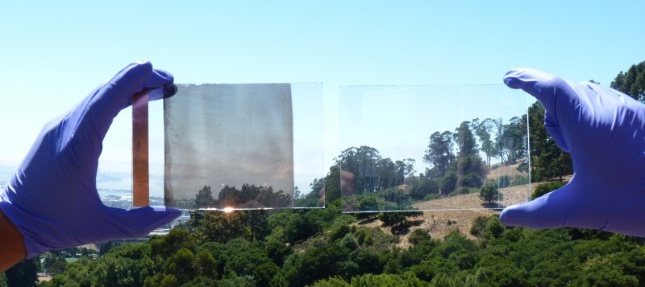
Smart windows can dramatically lower energy bills
Anna Llordés, Lawrence Berkeley National Lab
An example of the self-darkening glass next to a normal pane of glass in sunlight.
Notes:
Taken from: http://www.businessinsider.com/self-darkening-windows-regulate-light-and-heat-2013-8 published Aug 14th, 2013
A new nanocrystal glass has the ability to control the light and heat that gets through it, which means it could be used to make "smart windows" that could drastically reduce electricity bills.
Details of the new nanotechnology-based smart windows published in the Nature article below.
Tunable near-infrared and visible-light transmittance in nanocrystal-in-glass composites
Anna Llordés, Guillermo Garcia, Jaume Gazquez & Delia J. Milliron
Nature 500, 323–326 (15 August 2013) doi:10.1038/nature12398R eceived 14 December 2012 Accepted 12 June 2013 Published online 14 August 2013
Could drastically lower energy bills by decreasing the electricity used to light a house while also lowering air conditioning bills on hot days.
Windows coated with this material could be integrated with a climate control system that a user could program to change with the time of day, or respond to fluctuations in sunlight or outside heat.
"You would probably hook this up to some sort of control system that monitors light and heat and adjusts the window as needed," study researcher Delia Milliron, of Lawerence Berkeley National Laboratories, told Business Insider. "But you would always have an override switch if that was your preference, if it was too bright or if you wanted to darken it."
Smart windows made from electrochromic glass work by darkening when a low voltage current is sent through them. A coating on the glass reacts to current and changes color, blocking the light. This idea isn't new — electrochromic windows exist in buildings and homes, and even Boeing's Dreamliner's First Class cabin windows.
One drawback of currently available self-darkening windows is that they can't let in a lot of sunlight without also letting in the sun's heat.
The researchers solved this problem by mixing the Niobium oxide with special nanocrystals that can block the near-infrared rays that carry heat from the sun.

Slide 21
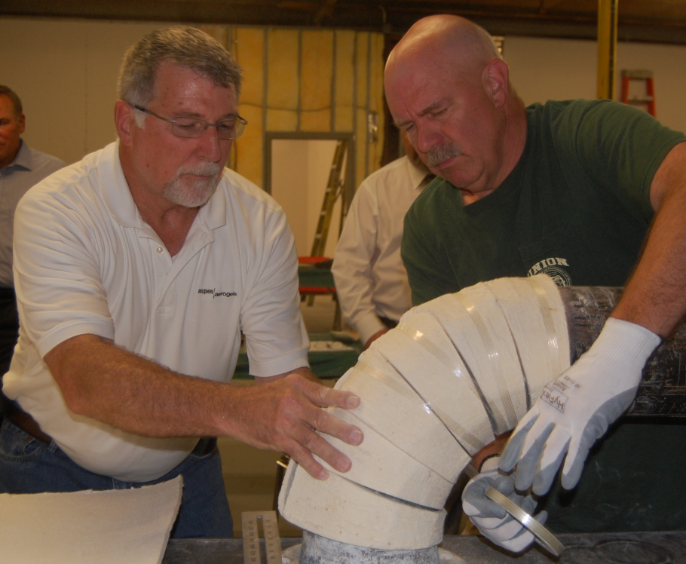
Aerogels insulate thermal systems and reduce noise
Average attenuations of -60 dB for a thickness of 70mm (2.76 in).
“Aerogel insulation sheets suffer from dust production.”
R. Baetens, Nanotechnology in eco-efficient construction, 2013
Notes:
Aerogels are tremendous insulators dropping noise levels 60 dB for a thickness of 70mm (2.76 inches).
As pointed out in a text on nanotechnology in construction: “Aerogel insulation sheets suffer from dust production.” R. Baetens, Nanotechnology in eco-efficient construction, 2013
This is a photo of the manufacturer’s technical expert (in white) working with a trainer from the Insulators Union to install an Aerogel insulation.

Slide 22
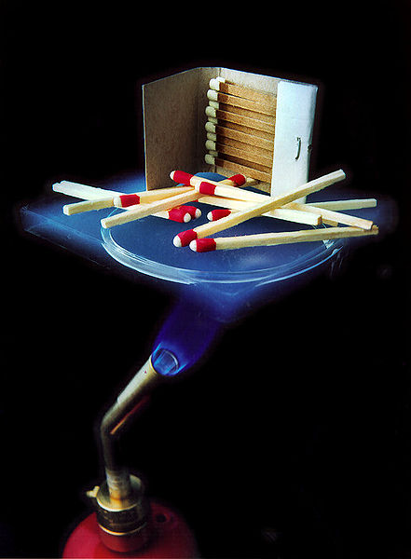
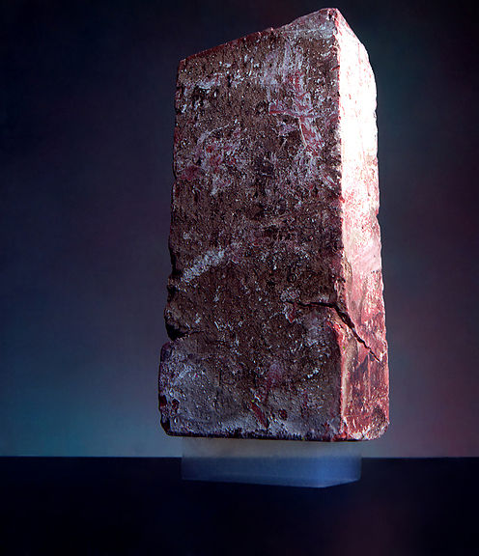
Aerogels are incredible insulators
Matches on a piece of aerogel over a bunsen burner
A 2.5 kg brick supported by a piece of aerogel with a mass of 2 grams
Photos courtesy Wikimedia and NASA
Notes:
From Aerogels are good thermal insulators because they almost nullify two of the three methods of heat transfer (convection, conduction, and radiation). They are good conductive insulators because they are composed almost entirely from a gas, and gases are very poor heat conductors. Silica aerogel is especially good because silica is also a poor conductor of heat (a metallic aerogel, on the other hand, would be less effective). They are good convective inhibitors because air cannot circulate through the lattice. Aerogels are poor radiative insulators because infrared radiation (which transfers heat) passes right through silica aerogel.
Owing to its hygroscopic nature, aerogel feels dry and acts as a strong desiccant. Persons handling aerogel for extended periods should wear gloves to prevent the appearance of dry brittle spots on their skin.
3.4. Safety aspects and fire behaviour
Aerogel insulation sheets suffer from dust production. As most of the commercial aerogel insulation products consist of complete amorphous (and thus 0% crystalline) silica, exposure limits in the range of 5 mg/m³ for respirable dust count in the US OSHA. However, the International Agency for Research on Cancer (IARC) considers synthetic amorphous silica to be not classifiable as to its carcinogenicity to humans (i.e. group 3). No evidence of silicosis has been found from epidemiological studies of workers with long-term exposure to synthetic silica, whereas studies of various animal species show that amorphous silica can be completely cleared from the lungs [48] and [82].
Monolith silica aerogels consists of SiO₂ with a −CH₃ treated surface for hydrophobisation. They are generally non-flammable and non-reactive. Also commercial products containing silica aerogels are considered to have the same properties [71]. Even more, aerogel insulation is used as fire-protecting material [1] and [55] where the PET fibres generally used for reinforcement are replaced [2].

Slide 23

They can be translucent, too

Slide 24
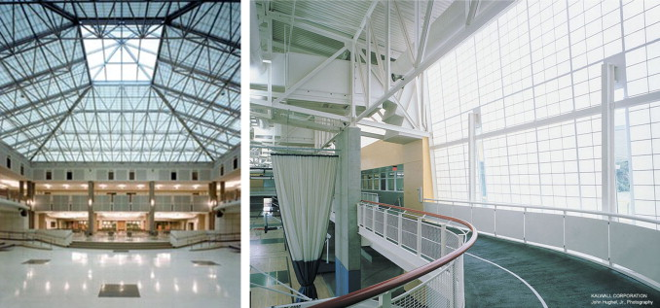
Translucent aerogel is used for thermal insulation and lighting
Baetens , Jelle & Gustavsen
Energy and Buildings Volume 43, Issue 4

Slide 25
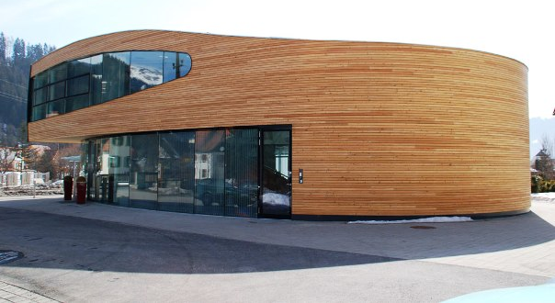
Nano-scale UV absorbers in coatings protect wood while remaining transparent
SDS
Nanovations Lignol wood coatings on red cedar
Notes:
Nanoscale UV absorbers offer unique benefits... The small size of the particles makes it possible to offer high protection without affecting the transparency of the impregnation

Slide 26

Water repellent surfaces for masonry are impressive
What is the nano part?
http://www.nanovations.com.au/Concrete.htm

Slide 27
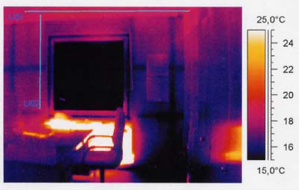
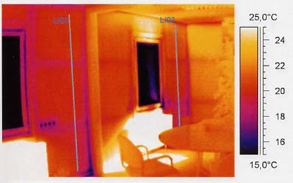

Paint with glass spheres distributes heat more evenly
Non-flammable, zero-VOC, Bioni Comfort can be applied over normal paint
Notes:
Nanovations Pty Ltd based in Sydney, Australia introduces Bioni Comfort, an interior wall coating with properties one can actually feel. With a special combination of binders and fillers which incorporate millions of
microscopically small hollow glass spheres, Bioni Comfort is able to ensure that the temperature in a room and on its surfaces is distributed more evenly.
The room climate and the degree of thermal comfort are thus noticeably improved. This is an effect that can be felt, as it directly affects the perceived temperature.

Slide 28

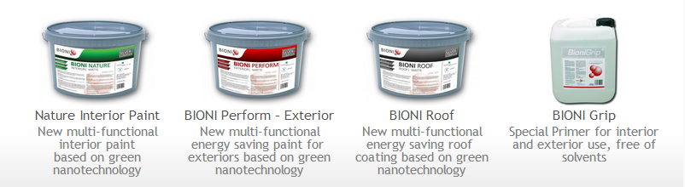
Paint containing silver and titanium dioxide acts as a biocide

Slide 29
Hydrophobic water-based cleaner for uncoated metal
SDS
Nanovations NH 2015 Metal
Contains “nano-scale hydrophobic active blend”
Notes:
NH 2015 Metal is a product for the removal of stubborn tea stains, oxidations and contaminations from uncoated metal surfaces like stainless steel, aluminum and other uncoated metals. A special formulated abrasive blend makes it easy to remove all stains . The nano scale hydrohobic active substance provide a long lasting , ultra thin protection and a durable easy to clean surface effect. Stainless steel and other metals will stay shiny and protected even at harsh marine environments or in areas with high pollution or dust levels. Older and contaminated surfaces can be brought back to the original conditions. Water runs off easily from the treated surface. The protective effect last up to 2 years, and show increasing life span with periodical application. During this time all contaminations can be wiped off with a wet cloth.

Slide 30
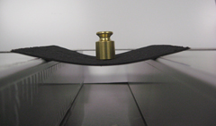
Buckypaper is a thin membrane of carbon nanotubes, nanofibers or other carbon nanomaterial
SDS
“…just another ply in the lamination process.”
Buckeye Composites, Division of NanoTechLabs, Inc.
Notes:
From the manufacturer: Buckypaper can be comprised of 100% carbon nanomaterial or can be pre-impregnated or “pre-pregged” with resin. Thickness and areal weight can be tailored to meet end-user requirements. Buckeye Composites’ buckypaper can be produced with any supplier’s carbon nanotubes or other carbon nanomaterial. This process versatility allows optimization of custom buckypaper formulations for a variety of applications.
By incorporating the carbon nanomaterial into a membrane, surface-dominated thermal and electrical properties of composite structures can be maximized. Buckeye Composites’ buckypaper can be handled in frozen roll form similar to aerospace carbon fiber prepreg materials and is essentially treated as just another “ply” in the lamination process.

Slide 31
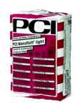
BASF tile adhesive is “lighter, more flexible and reduces dust”
“Unique binding agent incorporating the Nano technology”
Replaces the combined buttering floating method
Non sag consistency also with heavy and large size tiles
High coverage due to special filler combination.
Good curing properties, even at low temperatures.
Waterproof and frost resistant, to be used for ground level areas indoors and out.
Calcium diformate 1-3 %
Portland cement, chemicals, 25 -50%
Notes:
Optimized dust-reduced formulation
From the manufacturer: “PCI provides a complete dust-reduced product system for tiling. The dust-reduced products cover every single working stage around the tiling process: leveling, laying, jointing. Furthermore, they stand out due to very low VOC-emissions.
PCI Nanolight® is a dust-reduced tile adhesive that copes with all kinds of challenges during new construction or renovation. It is suitable for laying ceramic coverings of all types on all interior and exterior surfaces with different properties. Furthermore, PCI Nanolight® is easy to work on because of its low weight.
PCI Periplan®, a floor underlayment for correcting irregularities, dust-reduced and low in emissions in accordance with the GEV EC1 standard, and the dust-reduced flexible PCI Flexfug Extra® joint grout complete the optimized PCI product system.”

Slide 32
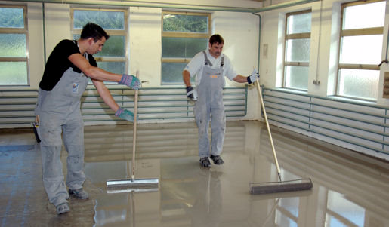
PCI Nanosilent combines leveling, isolating and sound reduction in one step
BASF: “Special polymers and rubber granules”
Notes:
From the manufacturer: “Leveling, isolating, reducing impact sound – the innovative PCI Nanosilent® isolation compound integrates these three steps into one single process. PCI Nanosilent significantly accelerates and simplifies floor work: After application and subsequent ventilation of PCI Nanosilent, tiling can begin right the next day. Waiting time between work steps is a thing of the past. But the simple and efficient application of PCI Nanosilent not only makes the tiler's work easier, it also makes renovation work for house-owners less complicated and more cost-effective: Working time is decreased which means less cost for man hours.
The unique characteristics of the PCI Nanosilent isolation compound are the result of the addition of special polymers and rubber granules. These rubber particles provide a high grade of elasticity and thus outstanding isolation and impact sound reduction properties.
Until now, if a customer’s flooring requirements included not only leveling of the surface but also isolation and impact sound reduction, various consecutive work steps were necessary: First, irregularities in the surface were leveled with a self-leveling compound. The cutting and placing of isolation panels could only be started after curing. This was very time-consuming, especially in rooms with a more intricate layout. PCI Nanosilent, however, can easily be applied in normally hard-to-reach corners as well.”

Slide 33
Explain why the uniqueness of construction poses additional risks to trades workers
1
2
Objective 2

Slide 34
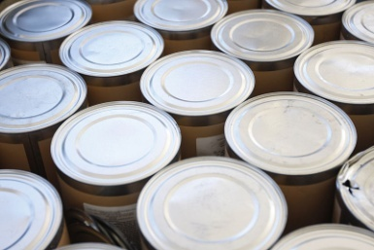
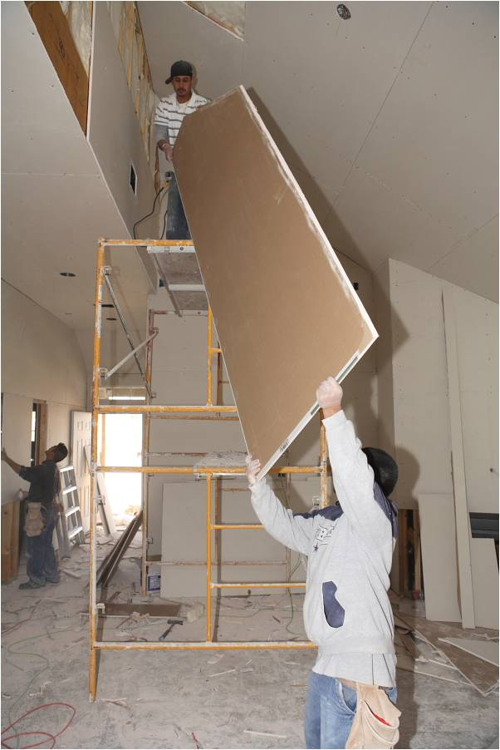
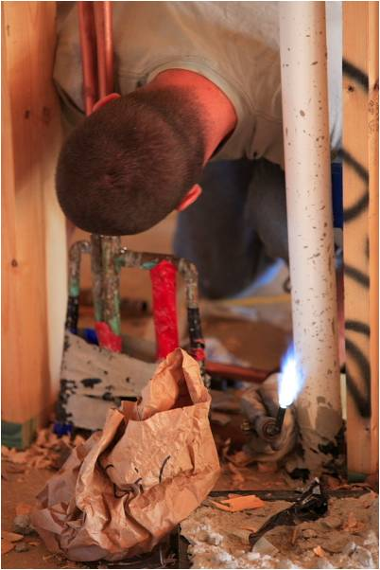
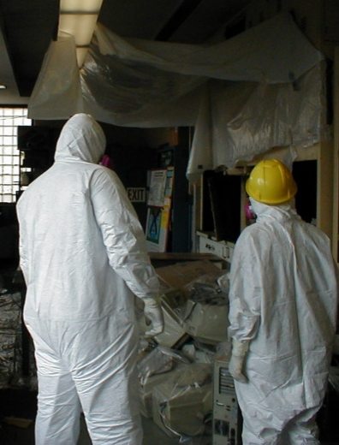
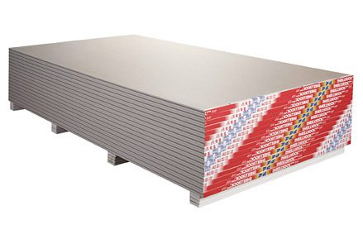
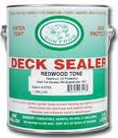
Exposures must be considered over the life cycle of products
Production
Installation
Maintenance
Demolition
What happens with Hazcom?

Slide 35

Bystander exposures are much more prominent in construction

Slide 36
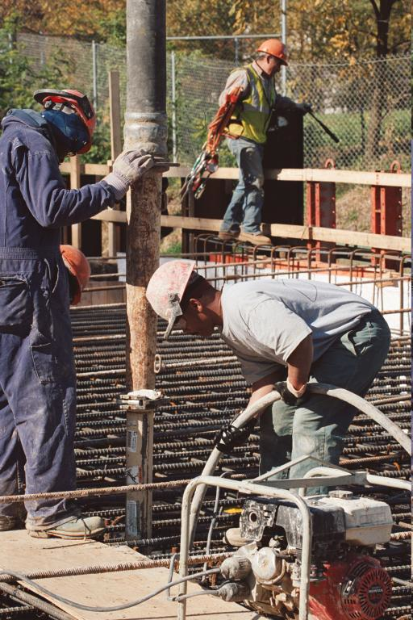
Multi-employer worksites complicate communication
Photo courtesy eLCOSH

Slide 37
Describe the specific health concerns posed by nanoparticles in construction
Objective 2
1
2

Slide 38
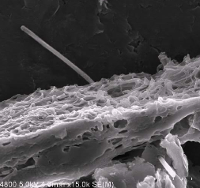
Mesotheliomas have been produced in mice with MWCNTs that are fibers with long aspect ratios (Takagi 08, Poland 08)
Multi-walled carbon nanotube penetrating the pleura of the lung. Courtesy of Robert Mercer, and Diane Schwegler- Berry, NIOSH

Slide 39
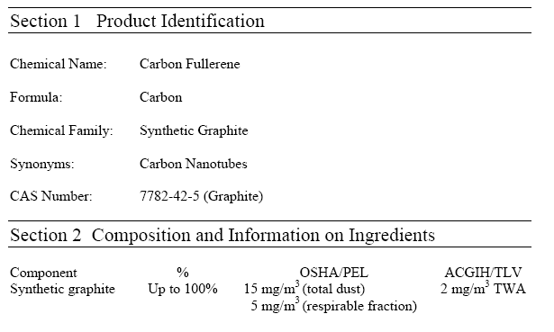
The new NIOSH REL for carbon nanotubes is 1 μg/m³
“Nuisance” dust standard for synthetic graphite:
15 mg/m³ total
5 mg/m³ resp
Notes:
This respirable amount is 5,000 times greater. Shvedova et all estimate that workers may be at risk of developing lung lesions if they were exposed to SWCNTs over 20 days at the PEL of 5 mg/m3

Slide 40
Workers may be at risk of lung lesions exposed to SWCNTs 20 days at 5 mg/m³
Shvedova et al., Am. J. Physiol. Lung Cell Mol. Physiol. 2005
Notes:
Shvedova et all estimate that workers may be at risk of developing lung lesions if they were exposed to SWCNTs over 20 days at the PEL of 5 mg/m3

Slide 41
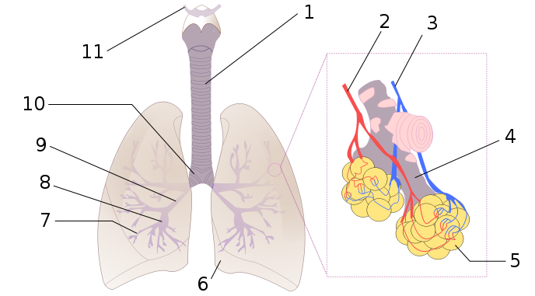
What is the main route of entry for nanoparticles?
Airborne NPs can be inhaled and deposit in the respiratory tract
Inhaled NPs may enter the blood stream and translocate to other organs
Image courtesy Wikimedia
Notes:
Trainer Notes:
The ability of a particle to deposit in the respiratory tract depends on its size. Particles larger than about 10 microns (10,000 nm) get trapped by the mouth, nose and throat; only particles less than ~10 microns enter the conductive airways (trachea and bronchi). Many of these particles are trapped by mucus and ultimately ingested. Nanoparticles’ small size permits them to be inhaled into the alveolar (deep) region of the lung where gas exchange occurs. For this reason, many studies and guidance documents have focused on inhalation as the primary route of exposure to nanoparticles in the workplace.
Animal studies have indicated that nanoparticles in the lung may be able to enter the bloodstream and translocate to other organs.
In many of these studies the nanoparticles were modified to prevent them from agglomerating together into particles larger than 2-3 microns. Some studies have shown that the primary effect of nanoparticles in the lung was asphyxiation when the particles clumped together and physically blocked the airways. The actual impact of a nanoparticle encountered in the workplace will depend critically on whether or not that nanoparticle agglomerates prior to or after entering the body.
SOURCE
Image: http://upload.wikimedia.org/wikipedia/commons/3/36/Respiratory_Tract.png

Slide 42
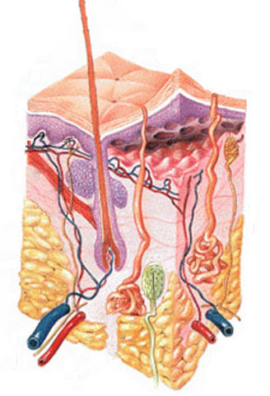
Results for skin are mixed, but problematic for construction workers
Several studies show little penetration of nanoscale oxides beyond surface skin layers
Metal nanoparticles have been shown to penetrate flexed, damaged or diseased skin
Quantum dots were found to penetrate intact pig skin within 8-24 hours at occupationally relevant doses
Notes:
Trainer Notes:
Research on skin as a route of exposure is more limited than that on inhalation. The methods for measuring skin penetration are still evolving and better validation and standardization are needed.
Dozens of papers demonstrate the ability of intact skin to protect against penetration of nanoparticles beyond the surface layers of the skin. This is particularly evident for titanium dioxide and zinc oxide nanoparticles used in topical sunscreens.
Fluorescently tagged polysaccharide (dextran) beads of 500- and 1000-nm diameter were found to penetrate to the dermis when the skin was mechanically flexed. Silver nanoparticles embedded in a wound dressing caused elevated levels of silver to be detected in plasma and urine and graying of the skin (argyria) of a burn patient.
Quantum dots of various sizes, surface coatings and shapes were found to penetrate intact skin to the epidermal and dermal layers within 8 hours. The researchers concluded that the time scale (typical work day) and dosage were relevant for occupational exposures.
Sources
Int Arch Occup Environ Health (2009) 82:1043–1055
IMAGE: http://en.wikipedia.org/wiki/File:HumanSkinDiagram.jpg

Slide 43

Ingestion is a viable route of entry; particles can translocate throughout the body
How do we ingest nanoparticles?
Ingested nanoparticles translocate to other organ systems
  SWCNT delivered into gut for treating Alzheimer’s disease were found in liver, brain and heart
  Ingestion of colloidal silver can result in permanent discoloration of skin, nails and eyes
Nano Mac?
Notes:
Trainer Notes:
Unintentional ingestion of nanoparticles may result subsequent to inhalation when mucus moves up out of the respiratory tract and is swallowed. (This clearance mechanism is called the mucociliary escalator.)
And, as is the case with other substances in the workplace, poor work practices, such as eating or smoking in the work area, can result in unintentional ingestion.
Occupational exposure via ingestion is perhaps the least well researched of the three pathways discussed in this module. However, the use of nanoparticles as drug delivery agents is a huge area in medical research. Some of these agents are meant to be ingested and then translocate to other areas of the body. This is itself demonstrates that ingested nanoparticles have routes out of the digestive tract and into other bodily systems. For example recently a single-walled carbon nanotube (SWCNT) agent introduced into rodent stomachs through gastrogavage was subsequently found in the liver, heart and brain as well as the lower intestine.
Excess ingestion of “colloidal” silver (much of which contains nanosilver) can result in a permanent discoloration of the skin (argyria) and eyes (argyrosis) from silver depositing into these tissues.
Sources
IMAGE: Microsoft image gallery
SWCNT: Nanomedicine: Nanotechnology, Biology, and Medicine 6 (2010) 427–441
Silver: Journal of Applied Biomedicine 2008, 6(3): 117-129

Slide 44
Ingested nanoparticles have been shown to…
Slightly damage liver (silver)
Trigger immune response in intestinal cells (TiO₂ and SiO₂)
Be cytotoxic to human intestinal cells (TiO₂, SiO₂ and ZnO)
Damage DNA of human intestinal cells (ZnO)
Be genotoxic to liver and lungs after oral administration (C₆₀ and SWNT)
Notes:
Trainer Notes:
There is limited research about the effects of nanoparticles post-ingestion. However, some studies indicate that certain nanoparticles have the potential to damage intestinal cells and, after translocating out of the gut, induce unwanted health effects in other organs. This research is too preliminary to draw major conclusions and most papers conclude that more research is needed to better understand the effects of ingested nanoparticles.
Sources
Silver liver damage: Particle and Fibre Toxicology, 2010, 7:20 (11 pp)
Intestinal dendritic cells: Nanotoxicology, 2010 Early Online, DOI: 10.3109/17435390.2010.506957
Cytotoxic: Nanotoxicology, 2009 3(4): 355-364
DNA damage: Nanotoxicology, 2009 3(4): 355-364
Genotoxicity: Environ Health Perspect 117(5), 703-708 May 2009

Slide 45
Discuss current findings on construction sampling including results from CPWR’s initial test
1
2
3
Objective 3

Slide 46
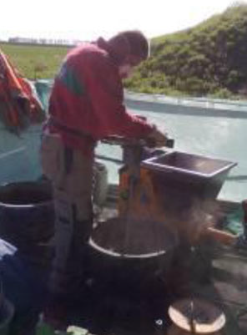
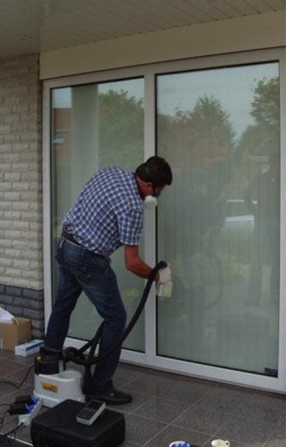
Sampling was conducted onsite for several real processes in the Netherlands in 2009 (Broekhuizen et al, 2011)
Mixing and applying Nanocrete mortar
Applying glass coating

Slide 47
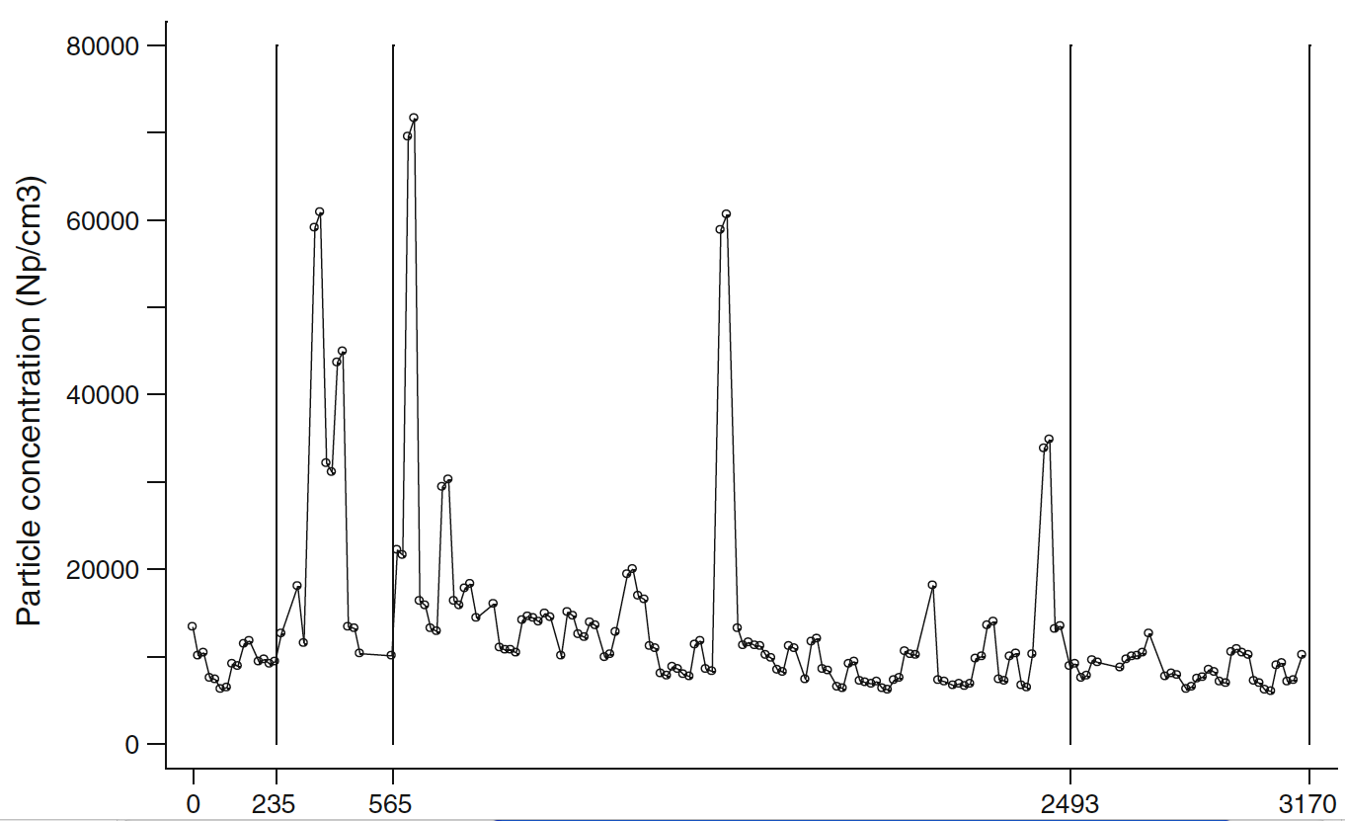
Particle sampling during mixing of 6 bags of Nanocrete mortar (Broekhuizen et al, 2011)
Smoking
Mixing
4
9.4
Time (min.)
41.5
53
“Workplace measurements suggest a modest exposure of construction workers to nanoparticles (NPs) associated with the use of nanoproducts.” *
Notes:
Note that the early peaks here are from someone lighting up a cigarette on site. There are lots of confounding sources of nanoparticles on a construction site.

Slide 48
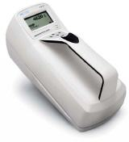



Many sampling methods are available, but data interpretation remains difficult
Condensation particle counter 10 - 1000nm range, p/cc
Optical particle counter, 300-10,000nm, p/l)
Scanning mobility particle sizers

Slide 49

We tested these smog-eating tiles that contain TiO₂

Slide 50


The Boral roofing system may require significant tile cutting
Notes:
Image from the manufacturer

Slide 51



CPWR conducted a range of sampling during the grinding, drilling and nailing of tiles outdoors

Slide 52


We collected respirable dust, TiO₂ (7300 and TEM) as well as CPC and OPC particle counts
CPC
OPC

Slide 53



We conducted sampling with local exhaust ventilation (LEV) on and off
RIDGID 15-Amp 7 in. Angle Grinder
Cut Buddy
Ermator S26 HEPA Dust Extractor

Slide 54

We next tested cutting this product in a chamber using a Bosch with 12” blade and Ermator S-26

Slide 55

Cutting across bevels was challenging for the ventilation

Slide 56

Dust levels without controls were extraordinarily high in the chamber

Slide 57
Use of ventilation in chamber was quite effective in reducing the dust
Sample | LEV On (mg/m³) | LEV Off (mg/m³) | % Reduction
Total dust (area) | 19.79 (n=15) | 675 (n =12) | 97.1%
TiO₂ (area) | 0.11 (n=15) | 1.97 (n=12) | 94.2%
Resp dust (personal) | 4.44 (n=8) | 81.17 (n=6) | 94.5%
TiO₂ (personal) | 0.04 (n = 8) | 0.34 (n=6) | 88.4%

Slide 58


Most results were encouraging
All measurements were below the new NIOSH REL for ultrafine TiO₂ of 0.3 mg/m³
Ventilation reduced total dust by 52.8% based on NIOSH 0500 (n=5 LEV on, n=5 LEV off)

Slide 59
Apply the hierarchy of controls to nanomaterials and explain what we know about controls
1
2
3
4
Objective 4

Slide 60
How many are not familiar with this?
Elimination
Substitution
Modification
Containment
Ventilation
Work Practices
Personal Protection
Engineering controls
Notes:
Trainer Notes:
Adapted from http://www.cdc.gov/niosh/topics/ctrlbanding/images/hierarchy_of_controls.jpg
This graphics shows the industrial hygiene hierarchy of controls. Controls are listed in decreasing order of preference. Modification, containment and ventilation are considered engineering controls and will be discussed in this presentation. Elimination and substitution were previously discussed and are preferred over engineering controls. Work practices, or administrative controls, and personal protective equipment are less desirable controls than engineering controls and will be discussed in the near future.

Slide 61
“The hierarchy predominated in governmental guidance [on nano] internationally.”
(Engman et al, JOEM, 9/13)
Notes:
Trainer Notes:
[Ask the question and allow time for discussion.]
How do we actually apply the hierarchy of controls to engineered nanoparticles?

Slide 62

Elimination
Elimination
Substitution
Modification
Containment
Ventilation
Work Practices
Personal Protection
Why is this the least practical control approach?
Fullerine nanogears, photo courtesy NASA and Wikimedia
Notes:
Trainer Notes:
Elimination: Why would we eliminate nanoparticles? Why is this the least practical control approach?
[These are important questions because engineered nanoparticles have obviously been added because they provide some added capability to the product that will go away if the nanoparticles are eliminated. Consider generating a discussion and writing the answers on the board. They might include:
Evaluation showed that the product released nanoparticles into the environment.
The added benefits were just marginal and the unknown risks weren’t acceptable.
Health complaints were being received from users of the product that may have been associated with the nano-sized component.]

Slide 63
Substitution
Elimination
Substitution
Modification
Containment
Ventilation
Work Practices
Personal Protection
What are possible difficulties with substitution?
Notes:
Trainer Notes:
[Ask these questions and try to generate a response before moving to the answer.]
Is substitution more likely than elimination?
What are possible difficulties with substitution?

Slide 64

Substitution isn’t as easy as it sounds
Each of the solvents above was replaced by another chemical that later proved harmful
Courtesy Michael Wilson, UC Berkeley
Notes:
Trainer Notes:
Substitution isn’t as easy as it sounds.
[It isn’t necessary to review all of these chemicals. The main point is to show that replacing Stoddard solvent in the seventies because it was a fire hazard with chlorofluorocarbons that aren’t flammable led to ozone depletion. They were banned in 1978 and replaced with methylene chloride, which turned out to be a carcinogen, etc.]

Slide 65

Nanotechnology Gasoline combines 60% gasoline with 40% drinking water plus proprietary nanotechnology
How does this work as a substitute for MTBE, tetra-ethyl lead or benzene?
Nano Labs Corp.
Notes:
From the manufacturer’s announcement: Nano Labs Corp. (OTCQB:CTLE) is pleased to present the industry with promising test results relating to a proprietary nanotechnology which replaces commercial gasoline.
The Company has successfully tested their Nanotechnology Gasoline (NG). The technology combines 60% commercial grade gasoline with 40% ordinary drinking water plus the Company’s proprietary nanotechnology. The result may mean an alternative to existing additives, like Ethanol, MTBE, Benzene, Methanol, and Aromatics additives that are harmful to the environment.
The Company has replaced 40% of gasoline with water and nanotechnology which thereby dramatically reduces the need of gasoline by over a third, thereby increasing fuel efficiency and reducing environmental emissions.
The Company reports that five gasoline mixtures were successfully tested; the tests were repeated three times over a period of thirteen months.
“Our new nano gasoline mixture combines our technology with normal tap water and gasoline which does not separate. In fact, it has remained intact after many months of testing. Also, the nano fuel does not freeze at temperatures of minus 40 degrees Celsius,” states Dr. Victor Castano, Chief Innovations Officer of Nano Labs. “This is by far one of the most interesting projects our teams are working on right now, a game changer in the energy sector.”
- See more at: http://nanolabs.us/press-releases/nano-labs-announces-promising-developments-in-nanotechnology-gasoline/#sthash.bff7gkMv.dpuf

Slide 66
Modification
Elimination
Substitution
Modification
Containment
Ventilation
Work Practices
Personal Protection
What modification could we make to reduce toxicity of nanoparticles?
Notes:
Trainer Notes:
[Ask the question.] “What modifications could we make to a process to reduce airborne nanoparticles?”
[The next slide answers this: keeping raw materials wet, if possible, can make a major difference.]

Slide 67




Effect of Surface Modifications
Courtesy Sally Tinkle, NIEHS
Fullerene
Derivatized Fullerene
C₆₀
C₆₀(OH)₂₄
Sayes et al., NanoLet, 2004
Notes:
This slide is courtesy of Sally Tinkle at NIEHS. Fullerines, Bucky Balls C-60 named after Buckminster Fuller, the creator of the Geodesic Dome. But this work by Sayes and colleagues in 2004 shows that there is a clear difference in the uptake of the same unit if there are surface modifications, in this case, the addition of hydroxyl groups. Note the activity in the lungs for the Fullerines.

Slide 68
Engineering Controls: Containment
Elimination
Substitution
Modification
Containment
Ventilation
Work Practices
Personal Protection
What are some examples of containment for nanoparticles?
Notes:
Trainer Notes:
Ask the question: “What are some examples of containment for nanoparticles?” The class should be able to give you some examples.

Slide 69

Nanocomp produces CNTs in these enclosed furnaces
Photo courtesy NIOSH and Nanocomp Technologies, Inc.
Notes:
Trainer Notes:
These furnaces are used to produce carbon nanotubes and are enclosed while production is underway.

Slide 70

Broader view of manufacturing containment
Photo courtesy NIOSH and Nanocomp Technologies, Inc.
Notes:
Trainer Notes:
[This shows the ventilation pulling from all of the furnaces up through a high-efficiency filter and then outside.]

Slide 71

Gloveboxes are a type of containment being used for handling nanoparticles
?
Nanomaterial testing. Photo courtesy EPI Services, Inc.
Notes:
Trainer Notes:
Gloveboxes are a type of containment that can contain work with raw nanoparticles. Point out the 25 mm cassette pulling air inside the box to determine how much gets airborne.

Slide 72
Engineering Controls:
Ventilation
Elimination
Substitution
Modification
Containment
Ventilation
Work Practices
Personal Protection
Notes:
Trainer Notes:
[Again, reiterate that we are moving from more protective to less protective as we move down the hierarchy.]

Slide 73


CPWR has demonstrated that LEVs work on construction

Slide 74

Wet methods will also work

Slide 75
PPE
Elimination
Substitution
Modification
Containment
Ventilation
Work Practices
Personal Protection
Should respirators work against nanoparticles? YES.
EPA requires full-face N-100 cartridge respirators for CNT manufacturers under a consent order, unless they prove no exposure.
Notes:
Trainer Notes:
[Again, reiterate that we are moving from more protective to less protective as we move down the hierarchy.]

Slide 76

What is the most penetrating particle size?
Efficiency
Particle diameter
Courtesy Roland Berry-Ann, NIOSH
Nanoparticles are effectively collected by diffusion.
Very large particles are effectively collected by impaction.
Notes:
Trainer Notes:
This is a concept that many people don’t understand because it isn’t intuitive. Most people when they think of filters, think of screens and assume that particles below a certain size naturally get through. This graph points out that the reason HEPA is defined as a filter that is 99.97 percent efficient at a 0.3 micrometer Median Mass Aerodynamic Diameter. That is the toughest particle size to capture because it is too small to catch with impaction, but too large to operate by diffusion. It operates under Brownian Motion. Consequently, if you can capture particles of 0.3 micrometer dimension at 99.97% efficiency, you do better with larger particles and with smaller partlcles, as this graph indicates.

Slide 77
Describe the current state of hazard communication for nano in construction
1
2
3
4
5
6
Objective 6

Slide 78
“80% of the workers’ reps and 71% of the employers’ reps were not aware of the availability of nanomaterials and were ignorant as to whether they actually use nanomaterials at their workplace.”
2009 Survey of workers and employers in 14 countries in Europe (28 responses out of 144)
Broekhuizen et al. 2011
Notes:
“80% of the workers’ reps and 71% of the employers’ representatives were not aware of the availability of nanomaterials and were ignorant as to whether they actually use nanomaterials at their workplace.”Part of the inventory was a questionnaire set out by the FIEC and the EFBWW among their members in 24 European countries (hereafter called the 2009-survey). A strategic selection of 144 well-informed FIEC and EFBWW contact persons in the Member States resulted in 28 completed questionnaires from 14 European countries. Completeness was not pursued, as this would require a much more elaborate approach. by in-depth interviewing of construction employers and workers, architects, raw material, and product manufacturers as well as R&D scientists, in total ca 45 interviewees from Western European countries and 5 from the USA and Canada.

Slide 79
A 2008 Lippy Group review of NIOSH’s collection of nano MSDSs showed challenges
N = 49 MSDSs
Reviewed all of the MSDSs
33% did not identify the nano component
52% did not have any cautionary language

Slide 80
62% just referenced PELs and TLVs for the macro size
Only 6% used cautionary language about using PELs/TLVs

Slide 81
The majority (67%) of Safety Data Sheets (SDSs) NIOSH collected in 2010-2011 “still provided insufficient data for communicating the potential hazards of ENM.”
Date collected | Satisfactory | In Need of Improvement | In Need of Significant Improvement
2007-2008, n = 32 | 7 (21.8%) | 13 (40.6%) | 12 (37.5%)
2010-2011, n = 21 | 7 (33.3%) | 10 (47.6%) | 4 (19.1%)
2007-2008, recollected in 2010-2011, n = 23 | 4 (17.4%) | 8 (34.8%) | 11 (47.8%)
Eastlake, Hodson, Geraci and Crawford, J. Chem. H&S, Sept/Oct. 2012
Notes:
This is NIOSH research.

Slide 82
Questions you might ask when evaluating nano Safety Data Sheets in your trade:
Does the SDS identify the nano-sized component?
Does it have any cautionary language about nano?
Does it use the PEL for the “macro” sized material?

Slide 83
List several resources that might be useful
1
2
3
4
5
7
6
Objective 7

Slide 84

NIEHS has the only guidance on training workers about nanotechnology risks
Notes:
Trainer Notes:
This NIEHS guidance on training workers is in final form and available on the web.

Slide 85
The guidance identified possible exposures among specific populations
Worker Population | Type of Nanomaterial | Tasks
Stationary engineers | Nanosilver biocides | Adding biocides to cooling tower water and HVAC drip pans
Cleanup workers | Nanoparticles in hazardous waste | Performing cleanup of waste sites
Nurses and physicians | Nanoparticles used in medicines; nanosiliver in disinfectants | Preparing intravenous liquids

Slide 86
The NIEHS guidance also provided:
Suggested learning objectives for a nanomaterials course for workers
Outline for 8-hour HAZWOPER refresher
Value of NIEHS Minimum Criteria in structuring nanoparticles training for workers

Slide 87


An 8-hour course is available for free at two locations
The GoodNanoGuide
OSHA Training Institute
www.goodnanoguide.org

Slide 88

Other resources:
OSHA Nanotechnology Topic Page
http://www.osha.gov/dsg/nanotechnology/nanotechnology.html
What you’ll find here
Relevant OSHA standards
New brochure on nano
88

Slide 89

NIOSH Nanotechnology Topic Page
http://www.cdc.gov/niosh/topics/nanotech/default.html
Recommendations and Guidance
News on OHS
89

Slide 90

AIHA Nanotechnology Working Group

Slide 91
Thanks! Questions?
Bruce Lippy, Ph.D., CIH, CSP
Director of Safety Research blippy@cpwr.com
301-578-8500
410-916-0359 cell http://www.elcosh.org
Notes:
Trainer Notes:
Try us out! Go to our site: http://www.elcosh.org or contact our Project Manager, Bruce Lippy:
Office: 301-578-8500
Cell: 410-916-0359

