Slide 1
Fixed Industrial Generators
2-hr Generator Safety Awareness

Slide 2
Topics We Will Cover
Background and Rationale
Important Safety Considerations
Prestart Checklist
Conducting a Test Run
2

Slide 3
TEST YOURSELF
How often do you inspect the generator?
How often do you test run the generator?
How long should you test run the generator?
Name two relevant OSHA standards.
Name two safety hazards when testing a generator.
For fixed generators, what is the ready position?
Which of the following have relevance in the inspection and test run of a generator?
Personal protective equipment
Asbestos precautions
Hearing protection
Lock-out / Tag-out procedures
Cleanliness
Log books
3

Slide 4
Objectives
KNOWLEDGE
Understand each step of a prestart checklist
Understand the operations and safe parameters of a fixed generator during a test run
SKILLS
Complete each step of a prestart checklist
Conduct a safe test run
Place the fixed generator back into the ready position
ATTITUDES
Be aware of the importance of weekly inspections and test runs
Contribute to a culture of safe work practices
Cite relevant OSHA standards and other safety considerations
4

Slide 5
Generators come in all shapes and sizes
5

Slide 6
Background and Rationale
6

Slide 7
Background and Rationale
Engineers and building operators should inspect and test run the back-up generator system once a week for a minimum of thirty (30) minutes.
Think about what this means:
(1) Inspect and (2) test run (3) once per week or (4) thirty minutes
What are some of the reasons ALL of these are so important?
7
Notes:
(Click to next slide for some of the reasons) These test-runs are necessary to ensure the reliability of the emergency power system. Back-up generators should always be in a state of readiness because of the critical functions they support. (List reasons on flip chart, once complete, post for the remainder of the week so students can refer to periodically).
Possible answers:
System readiness
Disasters/power outages are unpredictable
3. Required by code
4. Life support
5. Communications
6. Security
7. Safety
8. Continuity of Operations (COOP)

Slide 8
reasons
Systems readiness
Disasters / power outages are unpredictable
Required by code
Life support
Communications
Security
Safety
Continuity of operations (COOP)
8
Notes:
(List reasons on flip chart, once complete, post for the remainder of the week so students can refer to periodically)
These test-runs are necessary to ensure the reliability of the emergency power system. Back-up generators should always be in a state of readiness because of the critical functions they support.

Slide 9
Safety Considerations
9

Slide 10
Safety Considerations
Before a test run of a generator is conducted, workers need to be aware of proper prestart safety procedures.
What do you think some of those procedures need to be?
What OSHA standards do you think apply?
10
Notes:
Ask the class what they think some of the proper safety procedures would be, list them on a flip chat and post them for the class to see for the rest of the course.
Additionally, ask what standards from OSHA apply to these safe start practices. Again, post on a flip chart and post for the remainder of the class.

Slide 11
OSHA Safety Standards
29 CFR 1910 Subpart S – Safety-related Work Practices
1910.331 – Scope
1910.333 – Selection and use of work
1910.334 – Use of equipment
1910.335 – Safeguards for personnel protection
8

Slide 12
OSHA Safety Standards
12
Notes:
Open discussion with the class on proper hearing protection standard 29 CFR 1910.95 when working around a running generator.

Slide 13
OSHA Safety Standards
29 CFR 1910.133: Eye and Face Protection
13
Notes:
Open discussion with the class on proper eye and face protection standard 29 CFR 1910.133 when working around electrical equipment.
Image on left, face shields hanging and ready for use and on the right a United States Navy Electrician's Mate wearing a face shield while checking for bad fuses on a lighting panel aboard the USS Carl Vinson (CVN 70) source: Wikipedia.com

Slide 14
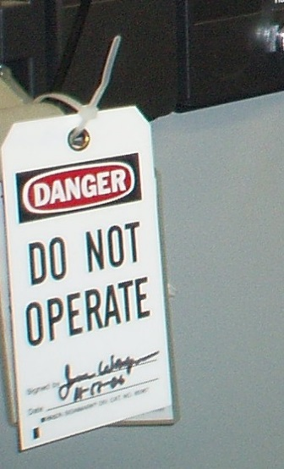
OSHA Safety Standards
29 CFR 1910.147: Lock Out / Tag Out
14
Notes:
Open discussion with the class on the Lock-Out Tag-Out standard 29 CFR 1910.147
Provide each student with a lock-out tag-out tag and the proper way to fill out the tag.

Slide 15
Prestart Check
15

Slide 16
Prestart Check
Manufacturer procedures should always be followed when conducting prestart and test runs.
16

Slide 17
Sample Checklist
The following slides provide a sample of a basic generator prestart and test run operational checklist and should be expanded upon depending on the needs of your facilities.
17
Notes:
A sample of a maintenance and inspection procedures prestart checklist for generators well as a test run log.

Slide 18
Prestart Check:
Review the generator logbook
Note the reading where the hour meter stopped. Is the reading on the generator the same?
Are there any maintenance repairs logged?
Any fuel deliveries?
Anything that may affect the running of the generator at this time?
18
Notes:
Show the class an actual emergency generator logbook and review the entries.

Slide 19
Prestart Check:
Turn off the generator
Never do a prestart check with the generator in the ready position.
Turn the generator from the ready position to the OFF position and tag it!
NEVER EVER leave to do something else with the generator turned off, it will be rendered useless if there were to be a power failure!
19
Notes:
In order to begin your prestart check list you need to first make sure the generator does not come on while you are checking the various components.
Stay in the moment! If you are called to do another task put the generator back in the ready (or auto) setting.
NEVER EVER LEAVE A GENERATOR IN THE OFF POSITION!

Slide 20
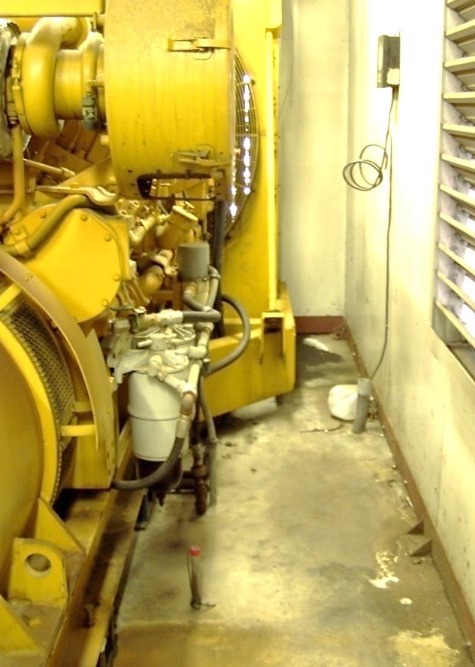
Prestart Check:
Check and clean the area around the generator
In outdoor units, trash and debris may have collected or blown in by the wind.
Look for objects that could be or have already been sucked into the fan.
Check for rodent nests (most diesel engines have warm water jacket heaters).
20
Notes:
Look to see that the area around the generator is free of debris. Paper and plastic can be drawn into the fan and lodged or entangled with the fan or against the radiator. This could potentially cause overheating of the engine.
Animals like to build nests near generators with warm water jackets such as those in diesel generators.

Slide 21
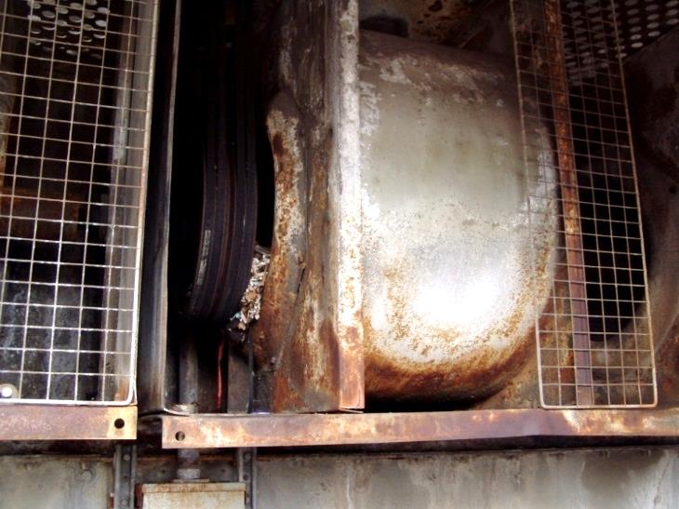
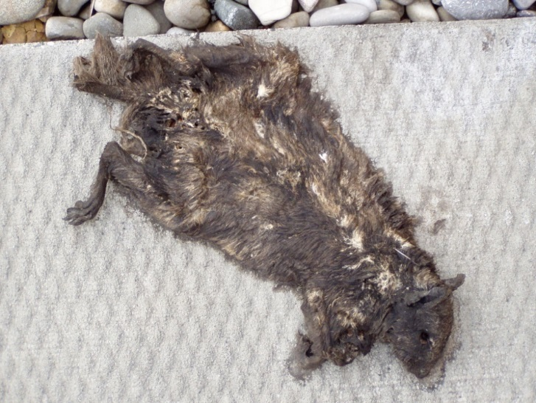
Prestart Check:
Check and clean the area around the generator
This is not a generator, but it does show what happens with a squirrel’s nest in a cooling tower fan.
Result of starting the fan.
21
Notes:
Animals can cause a great deal of damage to equipment that sits unused or is outside of the building. Check the area occasionally for nest or signs of rodent activity.

Slide 22
Prestart Check:
Check and clean the area around the generator
GOOD
OR
BAD?
22
Notes:
Mechanical rooms from time to time become storage areas. Make sure that the area around the generator is 1) free of obstacles that may inhibit good air flow around the generator and 2) free of material that could potentially become a fire hazard or a trip and fall hazard.

Slide 23
Prestart Check:
Check and clean the area around the generator
GOOD OR BAD?
GOOD OR BAD?
23
Notes:
Mechanical rooms from time to time become storage areas. Make sure that the area around the generator is 1) free of obstacles that may inhibit good air flow around the generator and 2) free of material that could potentially become a fire hazard or a trip and fall hazard.

Slide 24
Prestart Check:
Check battery and battery rack for corrosion
REMEMBER batteries can be explosive! Make sure you have the proper PPE on before you continue!
What PPE would be recommended in this situation?
24
Notes:
Safety First!
Revisit proper PPE for handling of batteries.
List examples and post.
Splash shield
Apron
Gloves
What else?

Slide 25
Prestart Check:
Check battery and battery rack for corrosion
Check the battery and rack for soundness
Clean the battery
Check the terminals
Look for corrosion or poor connections
25
Notes:
Poor connections of the battery terminals could prevent the generator from starting in an emergency situation.

Slide 26
Prestart Check:
Check battery and battery rack for corrosion
26
Notes:
Example of clean battery rack and battery with corroded battery terminals.

Slide 27
Prestart Check:
Check battery water level
Check to ensure that each cell has water and at the proper level.
27
Notes:
Carefully remove the caps from each cell of the battery to check for proper water level. If the level is low add distilled water to the cell.

Slide 28
Prestart Check:
Check charge operation and rate
Make sure that the charger is on
Ventilate the area
Check the charging rate
Make sure it is set at the proper voltage
28
Notes:
Batteries will lose their charge from sitting unused for long periods of time. Most generators are equipped with battery chargers to ensure that the generator has ample power to start the generator when needed.

Slide 29
Prestart Check:
Check engine radiator coolant level
Fluid is the lifeblood of the generator’s engine
Check the radiator for the proper coolant level
Remember to slowly open the radiator cap
NEVER OPEN THE RADIATOR CAP WHEN THE GENERATOR IS HOT!
In the fall, check the antifreeze level for proper low temperature settings for your area
Flush the radiator system annually to avoid the buildup of sludge
29
Notes:
Safety First! Practice safe work habits, NEVER OPEN THE RADIATOR CAP WHEN THE GENERATOR IS HOT!!
Remember to slowly open the radiator cap. Failure to do so could result in the person opening the cap (if the radiator is under pressure) being scalded.
Make sure the generator has the proper amount of antifreeze for the winter months.
After a period of time antifreeze can break down and become corrosive. Develop a preventative maintenance schedule for flushing the radiator system.

Slide 30
Prestart Check:
Check engine oil
Make sure the level is in the safe operational zone or range
Change the oil annually or after an extended operational period
It’s cheaper to change the oil than to have the engine replaced
30
Notes:
Check the oil level to see if it is in the safe operational zone.
If not, check the manufacture’s specifications for the proper oil for that generator. Different generators require different oil viscosities to ensure proper lubrication during heavy load demands.
Add oil until you reach the proper level and note the addition of oil in the generator log.

Slide 31
Prestart Check:
Check hoses and clamps
Check for sound hose connections
Examine each for dry rotting or cracking
Check for leaks
31
Notes:
Time is an enemy of rubber. Hoses may begin to show signs of dry rotting. Under operating pressures these hoses can burst sending hot fluids flying in all directions and could cause severe burns to individuals in the immediate area.
Additionally, the same thing could happen during an emergency call for power while you are not there. If the hoses were to rupture while you were absent from the area, the engine could suffer irreversible damage and the unit could be out of commission for an extended period of time.

Slide 32
Prestart Check:
Check fan belts
Stop! Recheck that the generator cannot come on automatically before you continue. Do not place your hand near the fan or the fan belt until you do so.
On the belts check for:
Dry rot
Cracking
Looseness
Proper adjustment
Worn or frayed areas
32
Notes:
Stop and recheck that the engine is off. Do not put your hands anywhere near the fan or fan belts until you do so.
Once done, check the fan belts for signs of being worn, cracked, dry rotted or stretched. If so have the belts replaced before continuing.

Slide 33
Prestart Check:
Check for leaks around generator
Look for any sign of fluids on the floor under the hoses and connections
If it is an outdoor generator check the structure for:
Leaky roof
Dampers not closing
Good seals on doors
33

Slide 34
Prestart Check:
Check fuel tank level
Check and ensure that the fuel tank is topped off monthly
Make sure that the vent line is free of obstructions
Make sure that the fill and vent lines are of the same size
34
Notes:
Here is an example of a bird’s nest in the underground fuel tanks vent.

Slide 35
Prestart Check:
Check fuel system
If your generator has fuel separators, drain them down to ensure that there is no water and/or sediment in them prior to starting the engine.
35
Notes:
Fuel tanks can accumulate moisture from condensation that can be drawn into the generator’s fuel system. Fuel oil separators placed before the generator enable engineers to remove any build up of water in the system before it enters the engine.

Slide 36
Prestart Check:
Check warning controls or lights
If your generator has warning lights, test each light to ensure it is in working condition.
36
Notes:
Check all system indicating lights to assure that they are functioning properly.

Slide 37
Test Run
37

Slide 38
Test Run:
Before you start
Remove all the tags from the control panel.
38

Slide 39
Test Run:
Start generator
After all of the different systems of the generator have been checked, start and begin the test run of the generator.
Don the proper hearing protection when running a generator.
39

Slide 40
Test Run:
Check the exhaust stack at start-up
FEW SECONDS.
CLEAR AFTER A...
IT SHOULD RUN...
40

Slide 41
Test Run:
Check the following systems
Oil Pressure
Water Temperature
Volts
Meter Hours Start Time
If possible test run your generator under load conditions.
41

Slide 42
Test Run:
Safety reminder
Remember when running your generator you are generating electricity!
42
Notes:
Safety First!

Slide 43
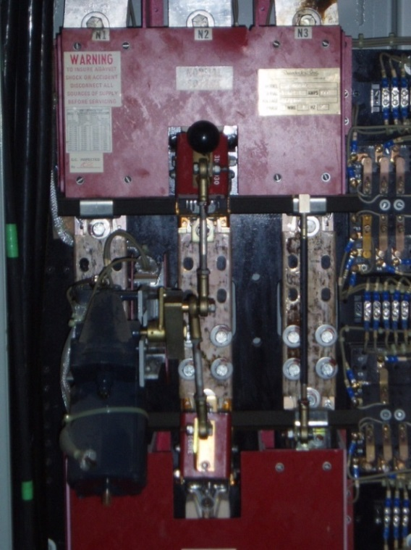
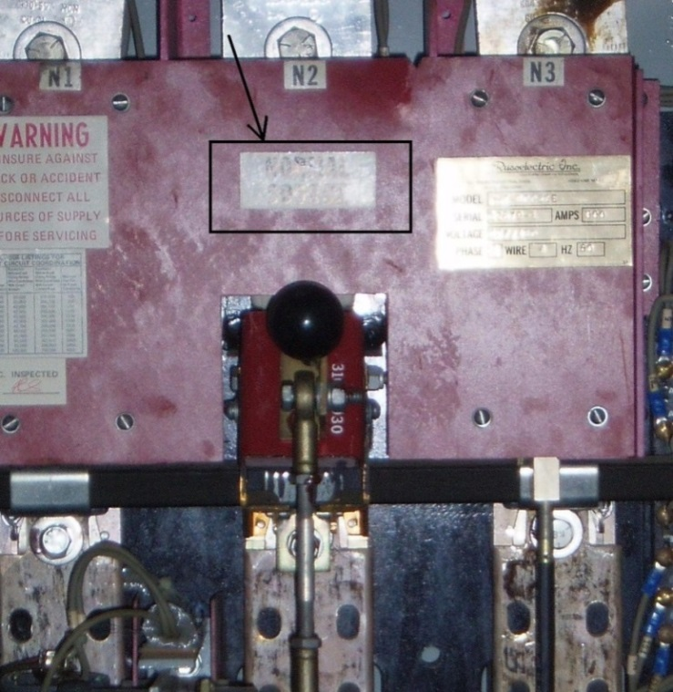
Test Run:
Transfer switches
Transfer switches when installed should transfer from commercial power to the generated power source.
43
Notes:
Transfer switches when installed should transfer from commercial power to the generated power source

Slide 44
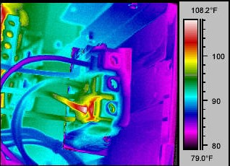
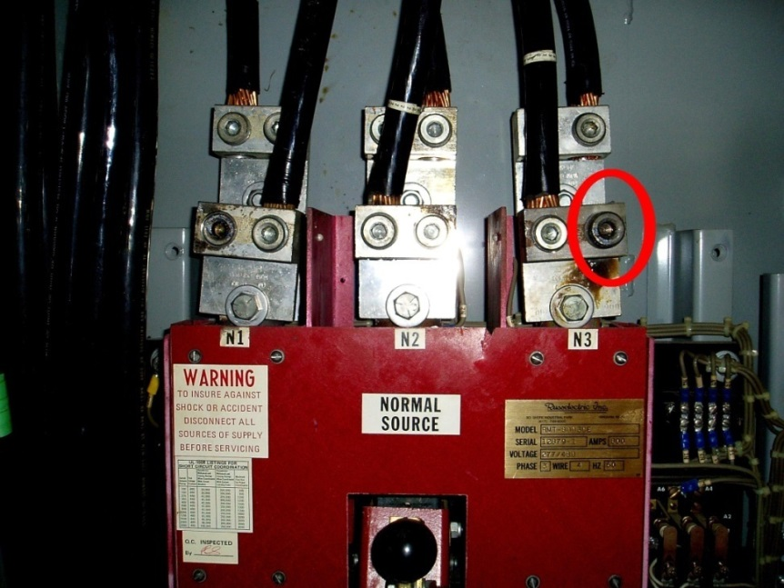
Test Run:
Transfer switches (accident)
Lugs came loose on transfer switches during test runs (due to lack of preventive maintenance).
44
Notes:
he lugs on this transfer switch became loose from expansion and contraction. Once the lugs start to become loose, the cables will heat up due to a poor connection. Periodically, preventive maintenance on these lugs has to be performed. “ALWAYS REMEMBER TO FOLLOW STRICT SAFETY PROCEDURES TO ENSURE THAT THE POWER SOURCE IS OFF AND DRAINED!!!!”

Slide 45
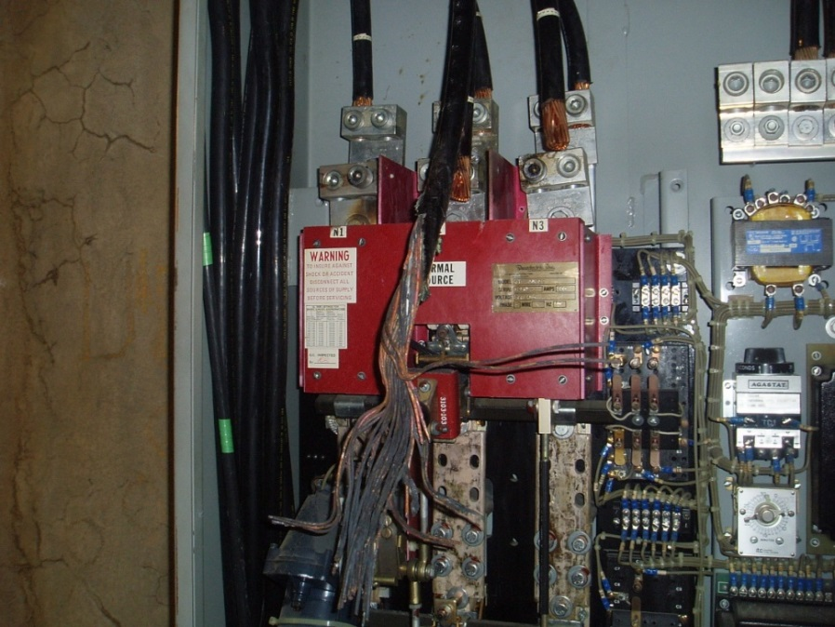
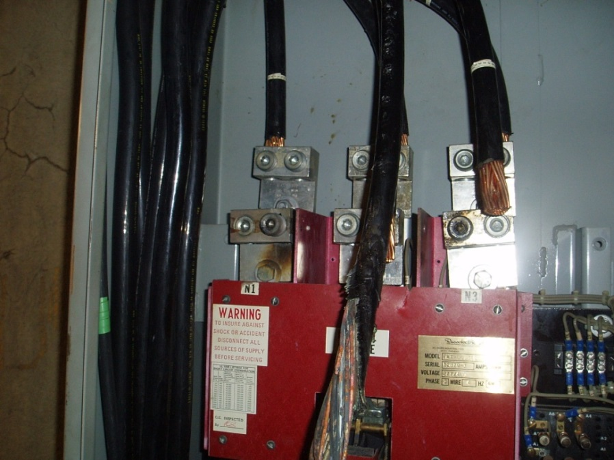
Test Run:
Transfer switches (accident)
Melted wires (due to lack of preventative maintenance).
45

Slide 46
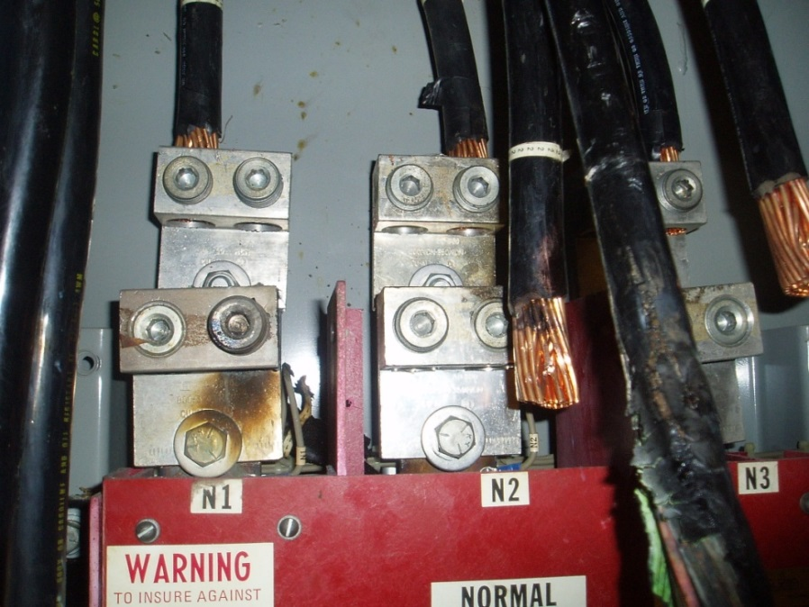
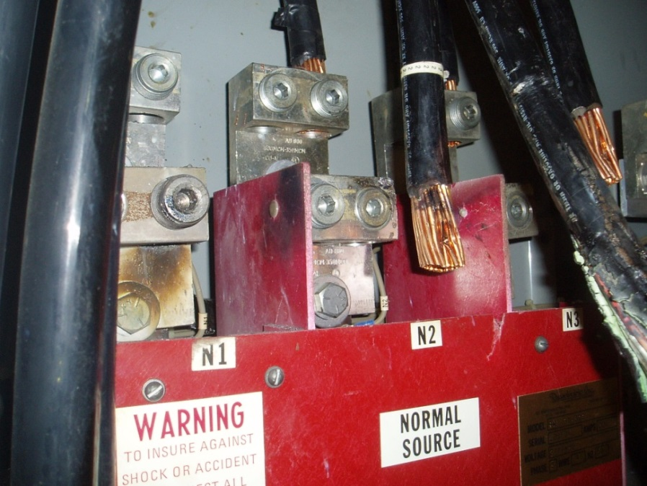
Test Run:
Transfer switches (accident)
Burnt lugs (due to lack of preventative maintenance).
46

Slide 47
Test Run:
Completing the generator test run
Cool down period: Once the generator has gone through a test run under simulated load conditions, the generator will enter the next phase, the cool down time
Log in all test run data.
47
Notes:
Some generators have a built in tier for cool down periods after a test run.
Log in any changes or unusual events and findings during the test run.

Slide 48
Test Run:
Reset the generator control switch
Set generator controls back to “ready to start" so it will be ready in an emergency
Remove any tag that you may have placed at the control panel
48
Notes:
When the test run is completed, always make sure that the generator is in the ready position in the event of a power disruption or failure.

Slide 49
?
Any Questions?
?
?
49

Slide 50
IN REVIEW
We Covered:
Background and Rationale
Importance of weekly inspections and test runs
Important Safety Considerations
Relevant OSHA standards and other safety considerations
How to contribute to a culture of safe work practices
Prestart Checklist
What is involved in each step of a prestart checklist
Conducting a Test Run
How to conduct a safe test run
The operations and safe parameters of a fixed generator during a test run
Placing the fixed generator back into the ready position
50

Slide 51
This publication was made possible by grant number 5 U45 ES006182-19 from the National Institute of Environmental Health Sciences (NIEHS), NIH. Its contents are solely the responsibility of the authors and do not necessarily represent the official views of the NIEHS, NIH.
(304) 253-8674
hazmat@iuoehazmat.org
www.iuoehazmat.org

