Slide 1
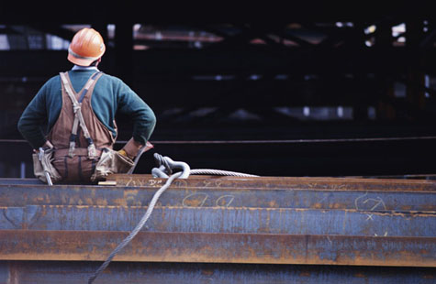
Health and Safety Aspects of the Construction Industry
Occupational Health: The Anna Baetjer Course
Bruce Lippy, Ph.D., CIH, CSP
Director of Safety Research, CPWR
5/5/12
Notes:
Trainer Notes
[Summarize this upcoming session, by telling the class that this module will focus on what supervisors should know about handling:
OSHA, particularly in the form of a compliance inspection on their site;
Reporters who may be interested in the story of their site; and
Disaster sites, which are also covered under HAZWOPER, but require very different supervisory skills.]

Slide 2
Topics we will cover:
Fatality and injury data for the construction industry
Major hazards on construction sites
Managing and controlling construction exposures
Safety of green construction
Construction workers during disaster responses
Notes:
Trainer Notes
[Review these learning objectives.]
Describe key elements under OSHA policy that affect supervisors, particularly onsite compliance inspections
List tips for dealing with the media on your sites
Describe how HAZWOPER supervisory roles are different on disaster sites compared to hazardous waste sites

Slide 3
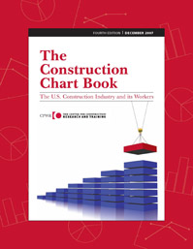
Fatality and injury data for the construction industry
Topic One
Notes:
Trainer Notes:

Slide 4
Rate of deaths from injuries in construction, selected countries, 2005

Slide 5
Rate of work-related deaths from injuries, by major industry, 2005 (All employment)

Slide 6
Rate of nonfatal injuries and illnesses with days away from work, by major industry, 2005 (Private wage-and-salary workers)

Slide 7
Rate of work-related deaths from injuries, selected industries, 1992-2005 (All employment)
Why does agriculture lead?

Slide 8
Rate of nonfatal injuries and illnesses with days away from work , selected industries, 1992-2005 (Private wage-and-salary workers)

Slide 9
Distribution of construction employment and work-related deaths from injuries, by establishment size, 2005

Slide 10
Percentage of injuries and illnesses resulting in days away from work, by ethnicity and establishment size, 2005

Slide 11
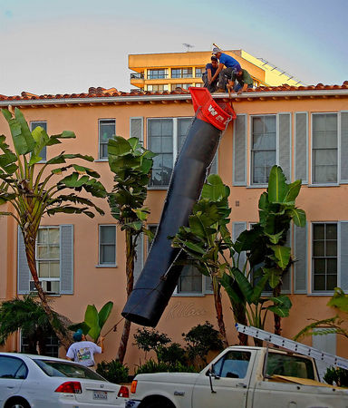
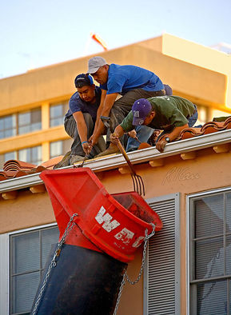
Latino crew at the leading edge
Photos courtesy of Robert Carr
Notes:
Trainer Notes:
You should ask this general question, but get the class to describe what is wrong with these specific images and what fall protection they should be taking. The photographer Robert Carr described the work scene below in his own words and noted that one of these three nearly fell while he photographed this work.
These excellent photos by Robert Carr show three roofers at the edge of roof, without fall protection, lifting and tying off flared top of trash chute with which to funnel old roofing material into dump truck for disposal. The crew is using two pitch forks (hand tools for roof demolition) to pry the top flared part of the chute over and above the roof edge and gutter. The worker on the right shortly thereafter lost his balance but recovered and sat down on roof, rather than pitching over the roof edge and falling two floors. The workers returned the next day to demolish the roof, including near edge, and walk along the edge of the roof to drop debris into chute. They should all be wearing body harnesses, with lanyards tied back with safety line to a secure support near center of roof. California, 2006.

Slide 12
Distribution of deaths from injuries in construction, by age group, 1992 versus 2005

Slide 13
Distribution of nonfatal injuries and illnesses resulting in days away from work in construction, by age group, 1992 versus 2005

Slide 14
Rate of work-related deaths from injuries, selected construction occupations, 2003-2005 average

Slide 15
Number of work-related deaths from injuries, selected construction occupations, 2003-2005

Slide 16
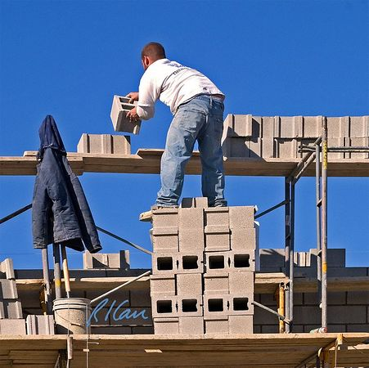
Major Hazards on Construction Jobs
Topic Two
Notes:
Trainer Notes:

Slide 17
Have you heard of the Focus Four hazards? Why does OSHA single them out?
Falls
Struck By
Caught in Between
Electrical
Notes:
Trainer Notes:
You may have already gone over these four, but give the class time to talk about why OSHA has singled these out among all construction hazards before going to the next slide. You may want to ask for any serious incidents that have occurred on job sites they have worked.

Slide 18
Out of 2,355 total construction fatalities, 79% were Focus Four hazards!
1,856 Focus Four fatalities in 2003/2004 (BLS)
Notes:
Trainer Notes:
Point out that this is why OSHA has focused on these four hazards. Together they represent 79% of the fatalities in construction work. This is Bureau of Labor Statistics data from 2003/2004.
There were 2,355 total fatalities, broken out as:
805 Falls
253 Electrical
570 Struck-by
228 Caught-in/between
499 All other (includes transportation related)
This means there were 1,856 Focus Four fatalities in 2003/2004!

Slide 19
Leading causes of work-related deaths, construction, 1992-2005

Slide 20
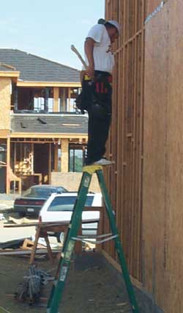
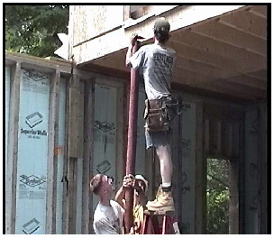
Falls
Notes:
Trainer Notes:
Everyone has seen this kind of misuse of stepladders. Ask the class if they have seen this, what is wrong with it, and what should these workers do to correct the situation.

Slide 21
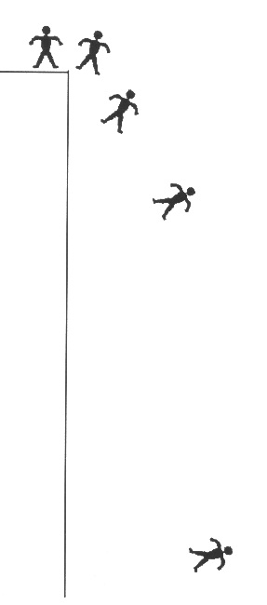
What happens when you fall?
0.33 sec./2 feet
0.67 sec./7 feet
It takes most people about 1/3 of a second to become aware
It takes another 1/3 of a second for the body to react
A body can fall up to 7 feet in 2/3 of a second
1 sec./16 feet
2 sec./64 feet
Notes:
Trainer Notes:
When a person falls they will accelerate in speed until they reach what is known as terminal velocity in which the person is no longer accelerating. This takes a long fall, such as from an airplane, but the velocity at this point can range from 120 to 200 mph! Imagine the impact.
Stress that there is a common fallacy that you can catch yourself somehow during most falls. In fact, it takes most people 1/3rd of a second to even grasp they are falling and another 1/3rd of a second to react, by which time they have fallen 7 feet. By the last 1/3rd of that first second of fall, the worker has dropped 16 feet. If the ground doesn’t interrupt, the worker will reach 64 feet by the next second.

Slide 22
Distribution of causes of deaths from falls in construction, 1992-2005 average
From girder, struct. steel (8%)
From scaffold, staging (18%)

Slide 23
Distribution of causes of injuries from falls involving days away from work, construction, 2005
Other (27.5%)
On same level (34.0%)
From roof (6.1%)
From scaffold (8.3%)
From ladder (24.2%)

Slide 24
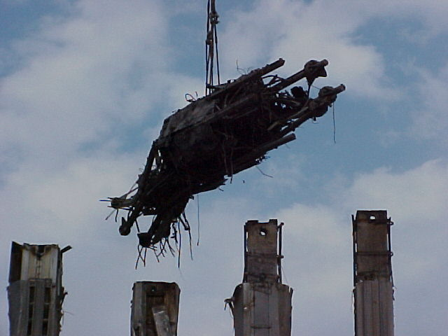
What are “struck-by” hazards?
Notes:
Trainers Notes:
This is common knowledge, but workers are still killed by being struck by loads. This shot is from the cleanup at Ground Zero. There were approximately 40 near misses at the site. One of those incidents involved several firefighters in a large pit looking for human remains when a large I-beam was going to be moved overhead. A safety person made them evacuate the area until after the pick, much to their dismay. While the beam was going directly over the pit, the I-beam failed from the heat and stress of the building collapse and fell right into the spot where the firefighters had been working. It surely would have killed one or all of them.

Slide 25
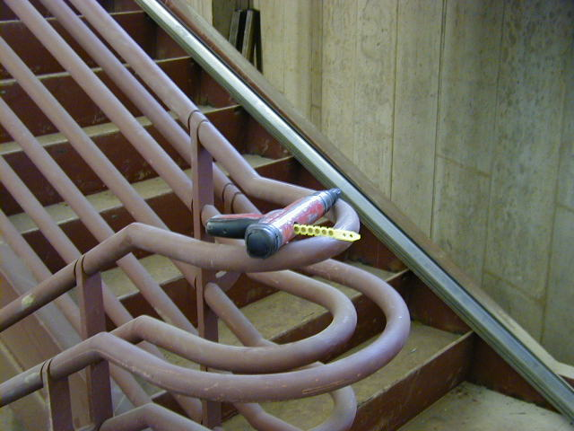
Powder-actuated hand tools
What are the hazards?
37,000 people go to emergency rooms from nail gun injuries every year
The hazards are similar to those of firearms
Sequential-trip triggers could prevent 65 percent of injuries
What is wrong with this picture?
Photo courtesy Laborers-AGC
Notes:
Trainers Notes:
Ask the question about what is wrong with the picture and be sure someone points out that the gun is setting precariously on a handrail with a charge still in it.
Answer: This is an OSHA violation of 1926.302(e)(6): “Loaded tools shall not be left unattended.”
Here is some background information from Wikipedia:
In the U.S., about 37,000 people every year go to emergency rooms with injuries from nail guns, according to the U.S. Centers for Disease Control (CDC). Forty percent of those injuries occur to consumers. Nail gun injuries have tripled from 1991 to 2005. All kinds of nail guns can be dangerous, so safety precautions similar to those for a firearm are usually recommended for their use. For safety, nail guns are designed to be used with the muzzle touching the target; they are short-range and inaccurate if a user tries to use one as a projectile weapon.
The most common firing mechanism is the dual-action contact-trip trigger, which requires that the manual trigger and nose contact element both be depressed for a nail to be discharged. The sequential-trip trigger, which is safer, requires the nose contact to be depressed before the manual trigger, rather than simultaneously with the trigger. Approximately 65% to 69% of injuries from contact-trip tools likely could be prevented through use of a sequential-trip trigger instead, according to the CDC.
Explosive-powered ("powder actuated") nail guns fall into two broad categories:
Direct drive or high velocity devices. This uses gas pressure acting directly on the nail to drive it.
Indirect drive or low velocity devices. This uses gas pressure acting on a heavy piston which drives the nail. Indirect drive nailers are safer because they cannot launch a free-flying projectile even if tampered with or misused, and the lower velocity of the nails are less likely to cause explosive shattering of the work substrate.
Either type can, with the right cartridge loads, be very powerful, driving a nail or other fastener into hard concrete, stone, or rolled steelwork with ease.

Slide 26
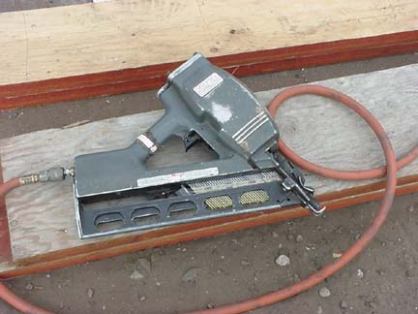
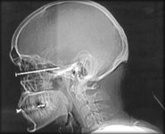
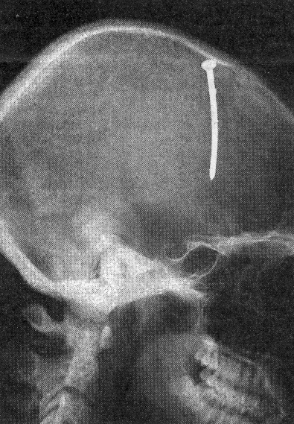
Pneumatic nailers have been made safer
Penetration checks must be made
All proper PPE must be worn
Notes:
Trainers Notes:
Pneumatic tools are powered by compressed air and include chippers, drills, hammers and sanders (Reese and Eidson, 2006). Only assigned, qualified operators should work with these tools.
Tools that shoot nails, rivets, staples and operate greater than 100 pounds per square inch (psi) must be equipped with a special device to keep fasteners from being ejected unless the muzzle is pressed against the work surface.
Eye protection is required and face protection is highly recommended.
Safety clip or retainer must be installed to prevent attachments from being unintentionally shot from the barrel.
Hoses need to be checked to be sure they are securely fastened.
Workers operating jackhammers must wear safety glasses, shoes, and hearing protection.

Slide 27
Distribution of causes of trenching-related deaths in construction, 2003-2005
Total = 159 deaths
Struck by vehicle part (8%)
Struck by vehicle load (8%)

Slide 28

Dedicated to Patrick Walters
One of over 50 workers who needlessly die in trenching and excavation each year
Notes:
Trainer Notes:
This is a chance to personalize the statistics that follow. Note that the PowerPoint brings his face closer at the end with an additional click. The figure of 50 workers is taken from the NIOSH data that is explained on the next trainer note.
Background on Patrick’s death
December 21, 2003 New York Times: As the autopsy confirmed, death did not come right away for Patrick M. Walters. On June 14, 2002, while working on a sewer pipe in Cincinnati in a trench 10 feet deep, he was buried alive under a rush of collapsing muck and mud. A husky plumber's apprentice, barely 22 years old, Mr. Walters clawed for the surface. Sludge filled his throat. Thousands of pounds of dirt pressed on his
chest, squeezing and squeezing until he could not draw another breath. His mother, Michelle Marts, was the first in his family to hear. "You just stand there like you're suspended in blank space," she said of that moment. She remembers being enveloped by a paralyzing numbness. He was her only child. She could not hear or breathe or move. Was this, she found herself wondering, what Patrick felt?
She called Patrick's father, her ex-husband, Jeff. "It literally knocked me off my feet," he said. "I lay there, right there on the floor, screaming and crying.“ Mrs. Marts next called Patrick's wife, Crystal. "I remember running upstairs and just hugging my kid
and thinking, `How am I going to tell her,' " Ms. Walters said. Her son had often spoken about his fear of being buried alive. He had described being sent into deep trenches without safety equipment, like the large metal boxes placed in excavations to create a sheltered workspace. "Was there a trench box?" she asked an investigator. He paused, she recalled. "He says, `Ma'am, no safety procedures were followed. None.'
"He was just so disgusted.“ Only two weeks before, the same investigator had caught men from the same company — Moeves Plumbing — working unprotected in a
15-foot-deep trench, a blatant violation of federal safety laws.

Slide 29
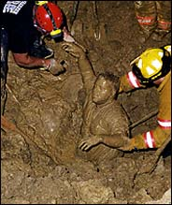
What do we know about the 542 “Patricks” who died in excavations from 1992 to 2001?
Average age was 38
Nearly half of their companies had less than 10 employees
Nearly all were employed by private companies
Cave-ins accounted for 76% of the deaths
Recovery of Patrick Walters’ body
Notes:
Trainer Notes:
Use the image to support the point that rescues from trench collapses are rare because the trenches have to be properly shored to make a rescue, which takes hours while workers die in minutes. Usually, as with Patrick Walters, there is a body recovery.
Review what we know about the data from these deaths:
Average age was 38
Nearly half of their companies had less than 10 employees
Nearly all were employed by private companies
Cave-ins accounted for 76% of the deaths
During 1992--2001, NIOSH identified 542 fatalities associated with trenching and excavation. Annual totals ranged from a low of 44 in 1993 to a high of 65 in 1996 and averaging 54 fatalities per year. The average age of decedents was approximately 38 years (range: mid teens to late 70s). Of the fatalities, 256 (47%) occurred among employees of companies with <10 workers, and 381 (70%) occurred in companies with <50 workers. The industries most frequently reporting fatalities were those involved in "excavation work," followed by "water, sewer, pipeline, and communications and power-line construction.” A total of 507 (94%) decedents were employed in private industry, 31 (5%) decedents were local government workers, and the remaining four (1%) were employed elsewhere. Although excavation and trenching fatalities occurred in various occupations, the largest proportion of deaths occurred among construction laborers. Cave-ins accounted for 76% of fatalities. Among decedents, the average length of employment with their employer was 6.7 years (range: <1--40 years); 86 (16%) deceased workers had been with their employer for <1 year.

Slide 30
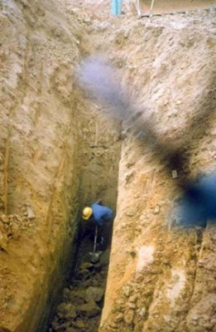
Is this a death trap?
YES!!
Notes:
Trainer Notes
Be sure to ask why this is a trench. We want to get the point across that it is definitely less than 15 feet wide. More important, we want to be clear that trenches like this are not just a serious violation of 29 CFR 1926.650 because they are deeper than 5 feet, but they are death traps. Some of the possible violations in this shot:
No protective systems, which are required if the trench is 5’ deep;
Spoil piles too close on the left; and
No means of egress within 25 feet.
We should definitely tell the workers to get out of any situation that dangerous. They could die at any time.
This case study does a great job illustrating how dangerous trenches can be:
August 5, 2007
The death of a plumbing contractor who was buried under an estimated 2,000 pounds of dirt after a trench collapsed was ruled an accident Sunday. Coroner's officials identified the man Sunday as Erick Acosta Hernandez, 26, of Aurora. He was working on a sewer line Saturday at a construction site when he dropped his shovel into a trench several feet deep, firefighters said. The trench, which did not have required safety supports, collapsed when the man entered the trench to retrieve the shovel, fire officials said. The man's co-workers were using a backhoe to try to remove dirt from around him before firefighters arrived. Fire Department spokesman Lt. Phil Champagne estimated Hernandez was covered for about 20 minutes. He was pronounced dead at a hospital Saturday afternoon, coroner's officials said.

Slide 31
Rate of deaths from electrocutions, selected construction occupations, 2003-2005 average

Slide 32
Deaths caused by contact with electricity among electrical workers in construction, 2003-2005 average
Total = 124 deaths
Lighting fixtures (17%)
Electrical equipt & wiring (44%)
Overhead power lines (32%)

Slide 33
Deaths caused by contact with electricity among non-electrical workers in construction, 2003-2005 average
Total = 238 deaths
Energized objects (5%)
Electrical equipt & wiring (15%)
Overhead power lines (57%)
Machinery & appliances (16%)

Slide 34
Managing and Controlling Exposures on Construction Jobs
Topic Three
Notes:
Trainer Notes:

Slide 35

American National Standards Institute has a standard called, “Occupational Health and Safety Management Systems”
ANSI/AIHA Z10-2005
Notes:
Trainer Notes:
American National Standards Institute has a standard called, “Occupational Health and Safety Management Systems”
ANSI/AIHA Z10-2005 has Section 3.2 Employee Participation

Slide 36
ANSI Z10 focuses on the strategic levels of policy and processes
Policy
Processes
Job Instruction
Documents
Layers of Management System Implementation
Notes:
Trainer Notes:
ANSI Z10 focuses on the strategic levels of policy and processes.

Slide 37
Z-10 specifically uses the hierarchy of controls (Section 5.1.1)
Most Effective
Elimination
Substitution
Engineering Controls
Warnings
Administrative Controls
Personal Protection
Least Effective
4-37
Notes:
Trainer Notes:
Adapted from http://www.cdc.gov/niosh/topics/ctrlbanding/images/hierarchy_of_controls.jpg
This graphics shows the industrial hygiene hierarchy of controls. Controls are listed in decreasing order of preference. Modification, containment and ventilation are considered engineering controls. Elimination and substitution are preferred over engineering controls. Work practices, or administrative controls, and personal protective equipment are less desirable controls than engineering controls and will be discussed in the near future.

Slide 38
ANSI Z-10 provides a framework built on a quality control model from business
Plan
Do
Check
Act
Notes:
Trainer Notes:
ANSI Z-10 provides a framework built on a classic quality control model from business. From Wikipedia: “PDCA was made popular by Dr. W. Edwards Deming, who is considered by many to be the father of modern quality control. Later in Deming's career, he modified PDCA to "Plan, Do, Study, Act" (PDSA) so as to better describe his recommendations. A fundamental principle of the scientific method and PDSA is iteration—once a hypothesis is confirmed (or negated), executing the cycle again will extend the knowledge further. Repeating the PDSA cycle can bring us closer to the goal, usually a perfect operation and output.[

Slide 39
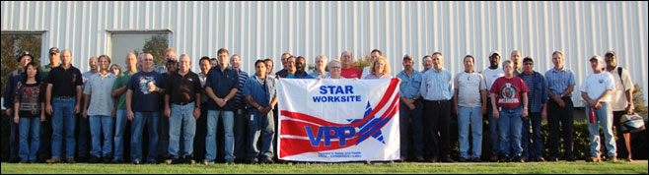
What key elements does ANSI, OSHA VPP and DOE ISM have in common?
Management leadership
Employee involvement
Hazard assessment
Hazard control
Worker training
Notes:
Trainer Notes:
What key elements does OSHA and DOE evaluate onsite?
Management leadership
Employee involvement
Hazard assessment
Hazard control
Worker training

Slide 40
Involving workers pays off! (Raines, 2011)
Gallup (2006) surveyed 125 organizations and found top fourth of the companies scoring on worker involvement had 62% less accidents than the bottom fourth
Molson Coors saved $1.7 million in safety costs in 2002 by strengthening employee involvement. Engaged employees were 5X less likely to have a safety incident and 7X less likely to have a loss-time incident
Notes:
Trainer Notes:
[These are studied quoted by Megan Raines in an April 2011 article in Professional Safety called, “Engaging Employees: Another Step in Improving Safety.”]
Many other studies support worker involvement
Gallup (2006) surveyed 125 organizations and found top fourth of the companies scoring on worker involvement had 62% less accidents than the bottom fourth
Molson Coors company saved $1.7 million in safety costs in 2002 by strengthening employee involvement. Engaged employees were 5X less likely to have a safety incident and 7X less likely to have a loss-time incident

Slide 41
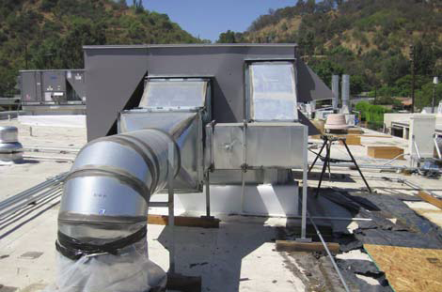
Let’s face a real supervisor’s choice
Commercial building HVAC / energy upgrades
Notes:
I’m the foreman – and I’m both labor and management. I’m a worker, and I’m the boss. I make over scale, and am responsible for getting the job done. I fire workers. I’m the face of the company.
We are changing out an energy hog A/C unit with a new unit. I took my crew of 4 to the job, laid out the roof penetrations and the duct runs, and got ready for the trailer with the new unit and the crane to arrive.
I didn’t know anything about the OSHA regulation that cranes must be 10 feet from power lines.

Slide 42
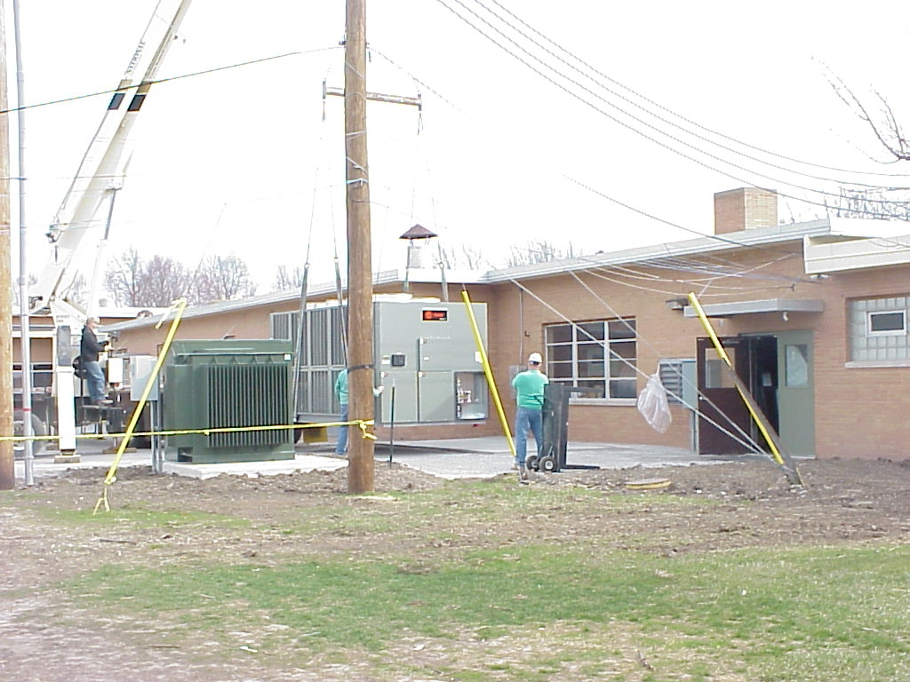
Must lift the unit on the roof from the wrong side of the building
Notes:
When the crane shows up, the operators points to the power lines, winks at me, and says, “don’t worry. I can squeeze it in there.”
Because I’ve had no training, and don’t perceive the hazard, I agree with the lift.
I’m the guy in the green shirt.

Slide 43
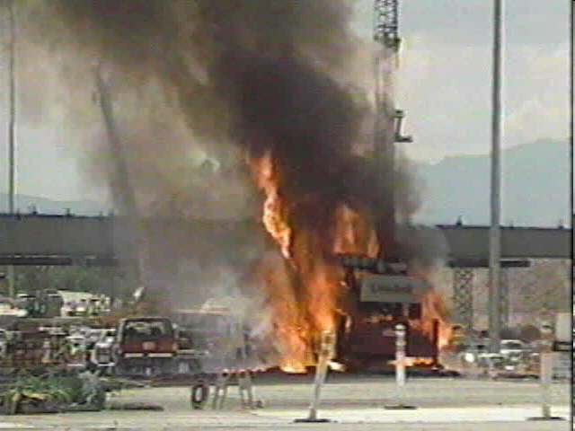
This could be the result. What do you do?
Notes:
A trained foreman would have seen pictures like this. Worse ones if he or she took the training from the guy who trained me. He really enjoyed seeing us squirm in our chairs by showing VERY graphic pictures.
Now I have to decide, do I call my superintendent and say, “we’re too close to power lines, and this crane you sent is too small to reach the roof penetration from any other side of the building. You’ll have to order a bigger crane. I know we have to pay for this crane today, but it’s too dangerous, sorry.”
Thinking, there goes my company truck and my 15% over scale.
Or do I say to the operator, “go ahead and squeeze it in there. I trust you not to touch those power lines.”

Slide 44
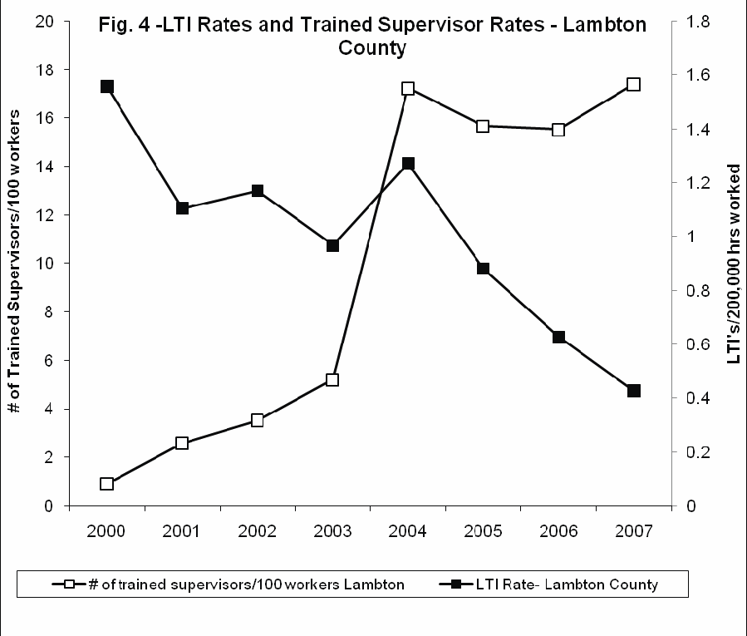
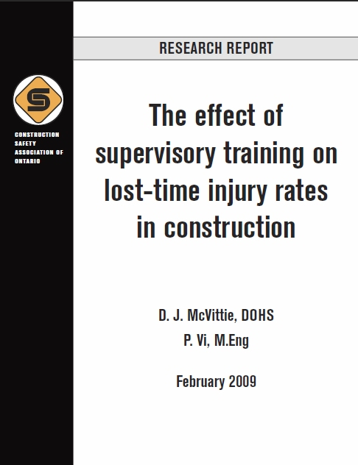
Training supervisors reduces lost-time injuries (Constr Safety Assoc of Ontario)
Notes:
Study by Construction Safety Association of Canada, McVittie and Eng, February 2009. The study examines data on injury rates and health and safety training for supervisors within the cohort of construction work undertaken on behalf of members of the Sarnia Lambton Industrial Education Cooperative, a group consisting of the major buyers of construction in Lambton County, Ontario, Canada.
The dual role of the foreman – worker and employer. I worked like everyone else to build the job, but I also fired workers for non-performance. I was the competent person who can stop work. I was also the boss wanting to make a profit.
Example: Small crane to lift AC unit near overhead power lines vs. large crane, more expensive, to reach from other side of building where there are no overhead power lines. The big crane is very expensive, and it would slow the job way down to order it. What should I do? What would you do?
Training supervisors / foremen reduces injuries. Gut feeling vs. empirical data. Seems obvious to me.

Slide 45
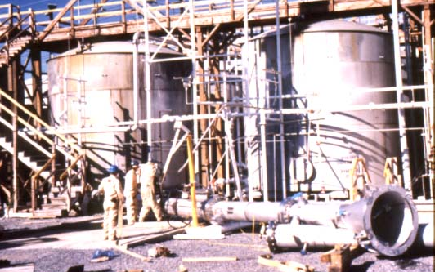
Getting to root causes isn’t easy. Go beyond blaming the workers.
Scrubbing tower dropped 10 feet from large tanks of acid
Notes:
Trainer Notes
This crew on an Army Corps of Engineers project dropped this 20’ long scrubbing tower they were putting in as an environmental control process. They were attempting to lift it over these two tanks of acid and sit it on the other side. They had two cranes: one to do the pick and one to stabilize the load. They started with cables but couldn’t keep it stable, then moved to straps. They kept lift it and it kept shifting. They would set it down, make some adjustments and lifted it again. They thought they had it and began lifting higher. The load shifted and one of the bolts at the flange cut through one of the straps. The load was now too heavy and the other strap failed and the unit came tumbling down about 10 feet from these acid tanks. The crew had no emergency plan, no assembly point, no spotter, no critical lift plan. The supervisor noted to the investigator that he “had told them knuckleheads to be safe but they never listen.” He wasn’t wearing his seat belt in the pickup as he drove the investigator to this site.
[Lead discussion on what “root cause” determination means. Start with work practices, but ask “What could we have done from a design standpoint.” A key piece of information is that the tank had no lifting lugs welded on to make a pic safer and easier.]

Slide 46
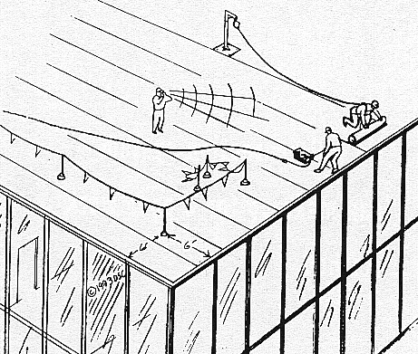
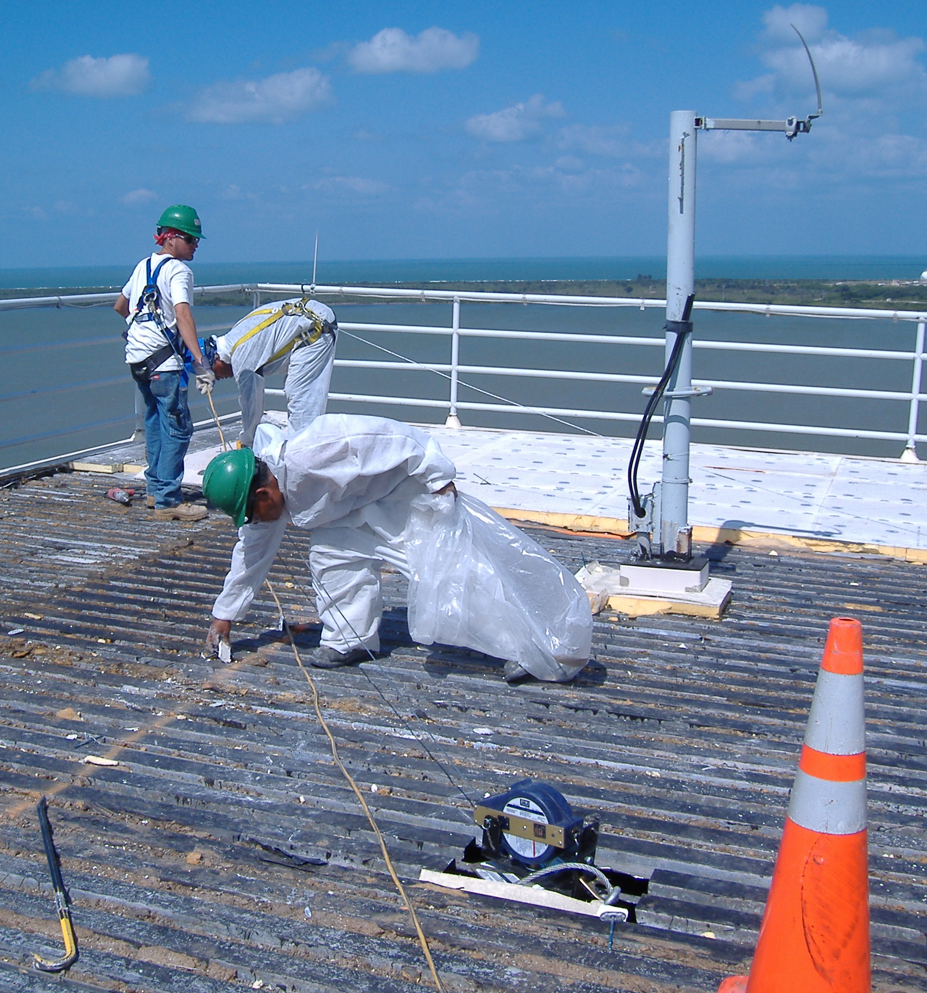
Here are the main systems for working safely on roofs. Any preferences?
Safety Monitors
Fall Arrest
Guardrails and warning lines
Notes:
Trainer Notes:
You may want to get into the OSHA definitions of “roof” and “roofing work”:
Roof means the exterior surface on the top of a building. This does not include floors or formwork which, because a building has not been completed, temporarily become the top surface of a building.
Roofing work means the hoisting, storage, application, and removal of roofing materials and equipment, including related insulation, sheet metal, and vapor barrier work, but not including the construction of the roof deck.
Definitely point out these three major approaches to protecting workers on roofs. Ask the class which level of the hierarchy of controls each approach represents. They should point out that:
Fall arrest systems are personal protective equipment
Guardrails are engineering controls. Warning lines might also be considered engineering controls, but should probably be called administrative controls.
Safety monitors are definitely administrative controls.
You might ask if, in this instance, administrative controls are more protective than PPE, which is the way we generally think of the hierarchy of controls. They aren’t. We should be clear that providing safety monitors is not nearly as protective as fall arrest systems, although the latter are cumbersome.

Slide 47
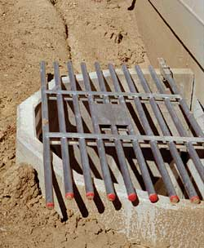
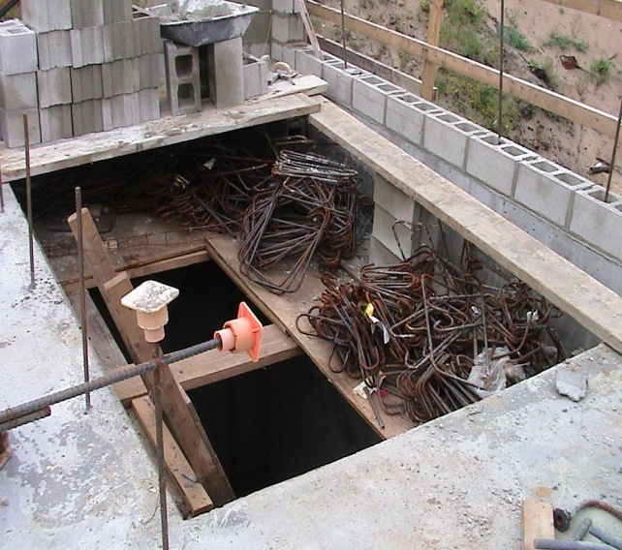
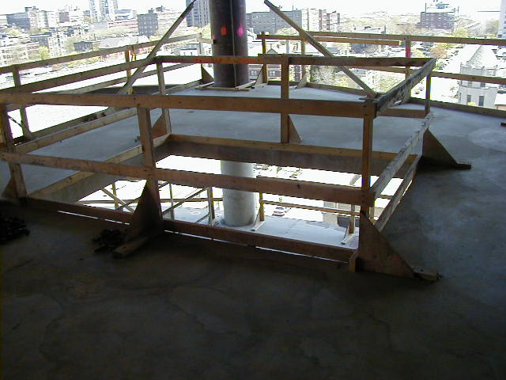
What practices are needed when working around holes?
Cover holes with materials of adequate strength and ensure they are secured
Mark covers so workers know there are holes underneath
Use guardrails
Photo courtesy of Laborers-AGC
Notes:
Trainer Notes:
Note that the OSHA standard requires that holes be covered “with materials of adequate strength.” Guardrails are required to withstand a 200 pound perpendicular stress. Covers must be able to support at least twice the weight of employees, equipment, and materials that may be imposed on the cover at any one time. To prevent accidental displacement resulting from wind, equipment, or workers’ activities, all covers must be secured. All covers shall be color coded or bear the markings “HOLE” or “COVER.”
Of particular interest to heavy equipment operators, OSHA does require that covers of trenches and holes on construction sites where trucks and equipment may run over them must support 20,000 pound:
1910.23(e)(7)(i)
Trench or conduit covers and their supports, when located in plant roadways, shall be designed to carry a truck rear-axle load of at least 20,000 pounds.
1910.23(e)(7)(ii)
Manhole covers and their supports, when located in plant roadways, shall comply with local standard highway requirements if any; otherwise, they shall be designed to carry a truck rear-axle load of at least 20,000 pounds.
Use these images to generate discussions on what is acceptable and what is not.

Slide 48
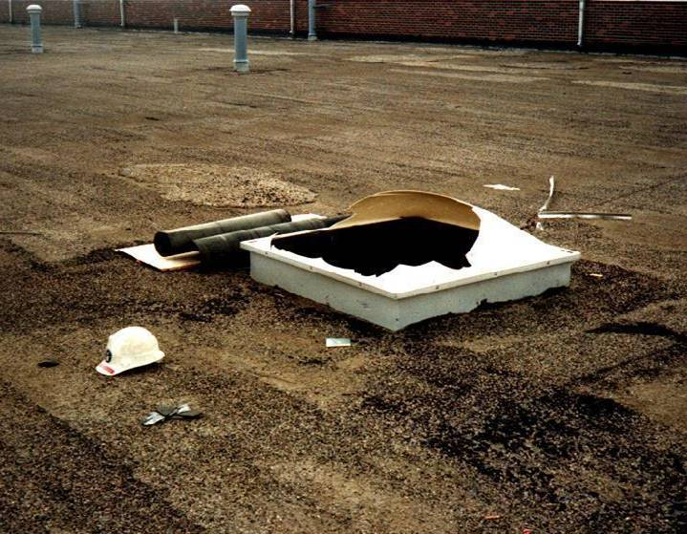
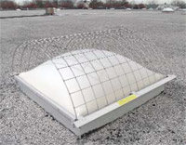
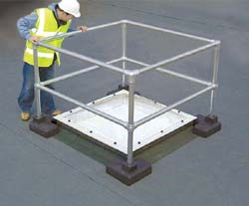
How can we apply the hierarchy to skylights?
Notes:
Trainer Notes:
Ask the main question and then answer it by pointing out the top photo where a worker fell to his death by sitting on the skylight. This has happened repeated, unfortunately. On a dirty roof, the plastic covers of a skylight draw workers who intend to sit and eat their lunch or take a break. They are not designed to hold the weight of a worker, however. Point out that OSHA requires they be either covered with a screen (lower left photo) or guardrails (lower, right).

Slide 49
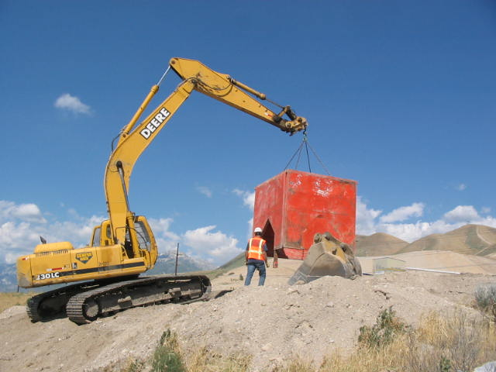
Trench shields or trench boxes are intended to shield workers from cave-ins
Photo courtesy Trench Shoring Services
Notes:
Trainer Notes:
This is a good image of a specialized box that clearly indicates it isn’t about shoring up the sides of an excavation, but preventing any collapse from getting to the workers. This photo is from a company called Trench Shoring Services. They have numerous excellent photos on their site that they graciously make available to others.
Their site: http://www.shoring.com/

Slide 50
Safety of Green Construction
Topic Four
Notes:
Trainer Notes:

Slide 51
Our current building costs are unsustainable
40% of raw materials consumed globally are used by the building construction industry
U.S. building construction:
  Uses 68% of total electricity consumption
  Creates 38% of carbon dioxide emissions
  Uses 12% of potable water
  Creates 272 million tons of construction and demolition waste annually
Source: The Guide to Green Buildings

Slide 52
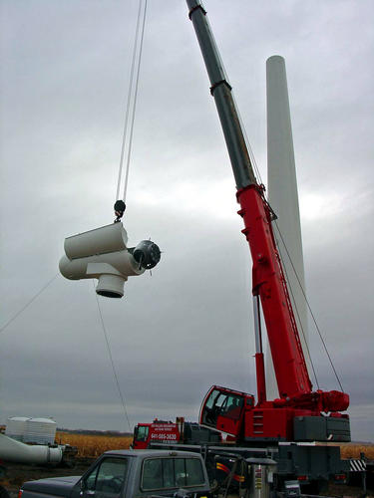
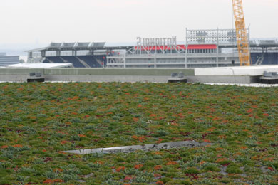
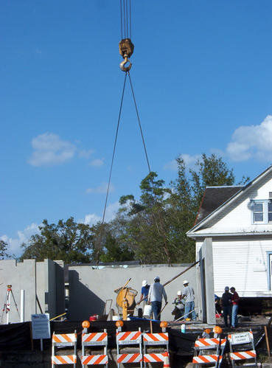
Examples of green construction projects
Wind turbine
Rooftop rain garden
Modular, insulated wall units
Notes:
Trainer’s Notes:
Ask students for other examples of green construction projects. Ask if anyone has been on one.
Green Roof info adopted from Design for Guidelines for Green Roof, Steven Peck and Monica Kuhn, B.E.S., B. Arch,O.A.A.):
Benefits include:
1. Energy savings
In the summer, green roof planting shades the building from solar radiation and, through the
process of evapotranspiration, can reduce, if not eliminate any net heat gain. This in turn
helps to cool the surrounding area, as well as decreasing the amount of energy required to
cool the building.
In the winter, the additional insulation provided by the growing medium helps to decrease
the amount of energy required to heat the building. The extent of the energy cost savings
impact is a function of:
• the size of the building
• its location
• the depth of the growing medium
• the type of plants and other variables
In one or two storey complexes where the roof is a large portion of the building envelope, the cooling energy savings in the
summer have been modeled as high as 25% as reported by Pers. Com. Dr. Brad Bass, Environment Canada, Adaptation and Impacts Research Group,
February 2001.
2. Roof membrane protection and life extension
3.Sound insulation
4.Fire resistance
5. Social and ascetic benefits
6.Urban Heat Island Effect
The urban heat island is the overheating of urban and suburban areas, relative to the surrounding countryside, due to increased paved, built-over, and hard surface areas. Average summer temperatures in major cities across North America have been on the rise over the past decade. These artificially high summer temperatures have a range of direct and indirect negative impacts on our quality of life. The urban heat island effect increases the use of more electricity for air conditioners and it increases the rate at which chemical processes generate pollutants such as ground level ozone. It also exacerbates heat-related illnesses. Green roofs intercept the solar radiation that would strike dark roof surfaces and be converted into heat, thereby improving energy conservation.
Like urban forests and reflective roofing surfaces they absorb and/or deflect solar radiation so that it does not produce heat.
An ASHRAE simulation conducted by the City of Chicago on their City Hall green roof showed that every one degree Fahrenheit decrease in ambient air temperature results in a 1.2% drop
in cooling energy use. The study suggests that if, over a period of ten years or more, all of the buildings in Chicago were retrofitted with green roofs, (30% of the total land area), this would yield savings of $100,000,000 annually from reduced cooling load requirements in all of the buildings in Chicago. The cooling would also slow the chemical processes that produce ground level ozone, nitrous oxides and smog, and help offset the production of sulfur dioxides from coal fired utilities.
7. Storm water retention
8.Air cleaning
9.Creation of habitats

Slide 53
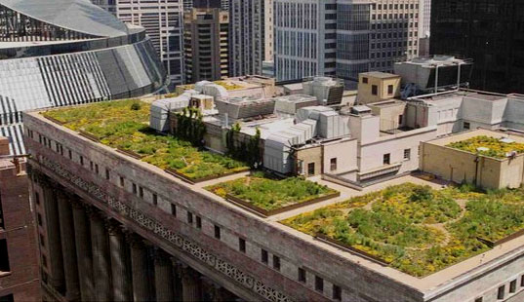
Green roofs have many advantages
A green roof in Chicago, courtesy of the City of Chicago
Notes:
Trainer’s Notes:
[Refer students to their books and review green roofs with them. Let the class know that some IUOE locals have landscape members who could build green roofs!]

Slide 54
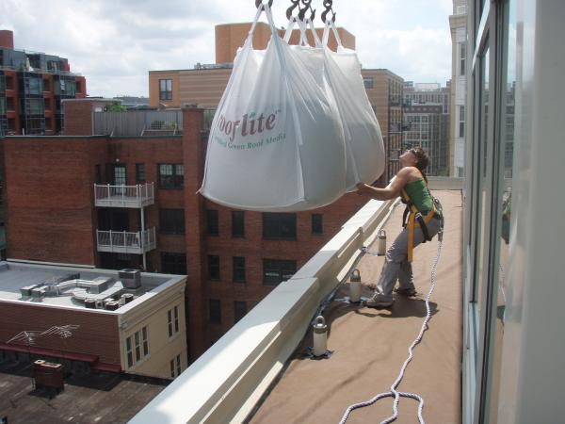
Can you think of any disadvantages?
This 2,300sf high-rise green roof is part of a modern building construct. A crane was used to lift the soil and gravel onto three floors, courtesy DCGreenworks.org and the IUOE
Notes:
Trainer’s Notes:
[Ask the class if there are any hazards associated with this installation of a green roof. Ask if they see any protective measures, e.g., fall protection.]

Slide 55
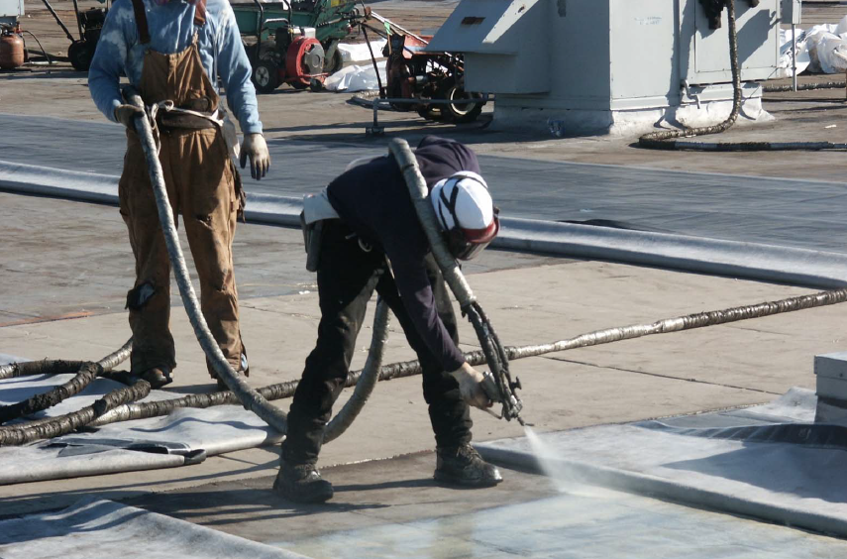
Weatherization is an important part of green construction. What risks from spray insulation?

Slide 56
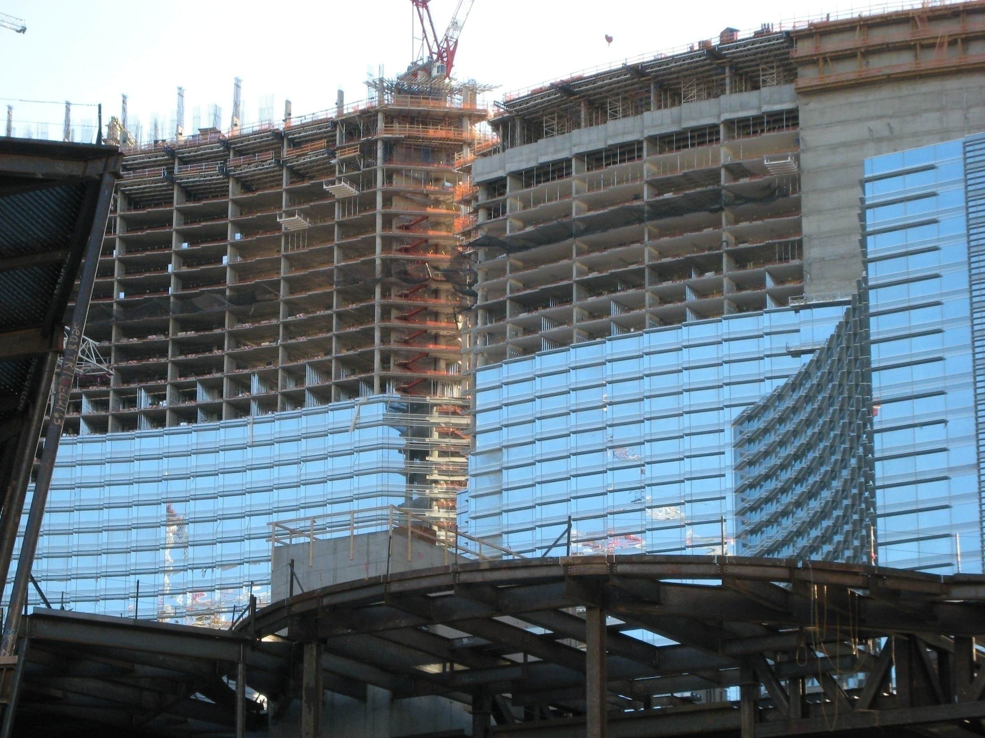
City Center, Las Vegas
Notes:
This job, the City Center project in Las Vegas, earned LEED’s Silver Certification as a Green Building. In a visit by CPWR as part of the NIOSH / CPWR team to evaluate the “safety climate” there, the team saw:
Serious heat stress – two ambulance calls the day I was there, curtain wall created heat and humidity cauldrons.
LEED jobs can favor environmental considerations over occupational ones.

Slide 57
“How many construction site deaths should there be to make a building not green regardless of the environmental benefits?”
Notes:
Did they die because it was a green job?
Or because it was a rush job?

Slide 58
Construction workers during disaster responses
Topic Five
Notes:
Trainer Notes:

Slide 59
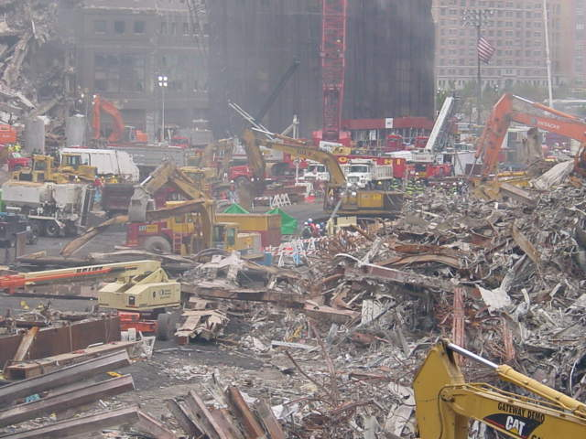
Why do disaster sites present greater risks?
Notes:
Trainers Notes:
This image is from the World Trade Center. It is a good shot for leading a discussion on why disaster sites present greater risks than a normal construction job or even a demolition project. Some of the answers you should get out of discussion include:
Heavy equipment often has to work much more closely than normal.
During the rescue phase there is a tremendous rush to save survivors even though the hazards may not be fully known.
Work surfaces, particularly for heavy equipment, may not be stable or level.
Hazardous materials may be present, possibly buried in debris.
The psychological shock of seeing dead or severely injured people adds to the stress.
Rescue workers often do not get enough sleep, which puts them at risk.
Construction workers often don’t know the Incident Command System, which may complicate how they work.
Emergency responders may attempt to direct heavy equipment, but they don’t know how to signal operators.
Fire fighters and police do not know how to approach heavy equipment and may be in the blind spots of the equipment.

Slide 60
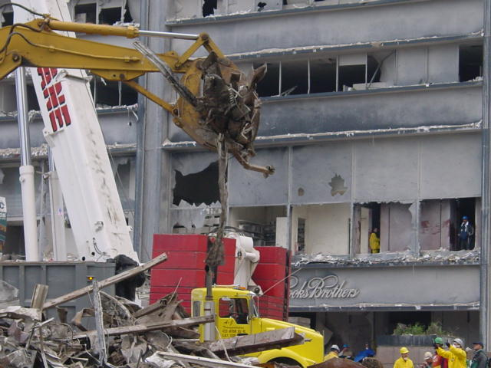
Greater chances are taken, like at the World Trade Center.
What is the violation here?
Notes:
Trainers Notes:
Along with the other items, unfortunately, on many disaster sites, greater chances are taken under the addage “risk a life to save a life” which is very misguided. In this shot at the World Trade Center the grappler is moving debris directly over the cab of the truck, which is a bad practice.

Slide 61
What were the most deadly disasters from 1992-2006?
Frequency
Bureau of Labor Statistics
Source: U.S. Bureau of Labor Statistics, Census of Fatal Occupational Injuries, 2007
Notes:
Trainers Notes:
This graphic is from Gregory Fayard who works for the Bureau of Labor Statistics. It is taken from the Census of Fatal Occupational Injuries. It is important to point out that these deaths are just among responders to disasters, including heavy equipment operators, not the public. This graphic allows you to point out the main killers are wildfires, hurricanes and floods.

Slide 62
Activities during hurricane-related fatalities (Fayard, APHA, 2006)
Other (16%)
Law and
order (6%)
Cleanup, debris removal, tree trimming (44%)
Restoring public
utilities (8%)
What is the lesson here?
Restorative
construction (26%)
Source: U.S. Bureau of Labor Statistics, Census of Fatal Occupational Injuries, 2007
Notes:
Trainers Notes:
After noting that responding to hurricanes caused the greatest loss of life, point out that the lesson from this graph is the largest portion of those deaths occurred during cleanup, debris removal and tree trimming (44%). Construction workers need to understand that they are the ones doing much of this work.

Slide 63
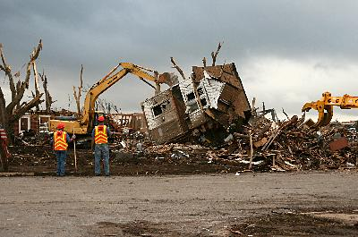
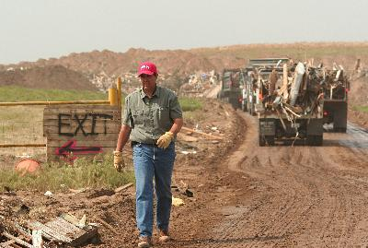
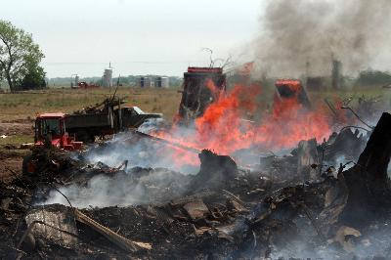
Tornado destruction poses serious risks for cleanup and disposal
Check OSHA’s website for guidance
Clean-up of F5 tornado in Greenburg, KS, May 07
Disposal and burning of debris at the Greenburg dump, nearly entire town needed to be burned
Photos by Greg Henshall, FEMA.
Notes:
Trainers Notes:
Point out that OSHA’s website has considerable guidance for protecting workers on disasters sites.
Cleanup: Greensburg, Kansas, May, 2007 - Public Works employees take down what was left of a home, nineteen days after an F5 tornado destroyed most of the town. The debris will removed to the local dump by the end of the day. Photo by Greg Henshall / FEMA
Disposal: Greensburg, KS, May, 2007 - Mike Perkins, an employee of nearby Lawrence County, helps direct traffic at the Greensburg dump. Debris from the May 4 tornado is either burned or buried depending on the material. .Dump trucks run non-stop, depositing debris in one of the burning pits at the landfill west of town. Almost the entire town will have to be razed after the F5 tornado struck on May 4.

Slide 64
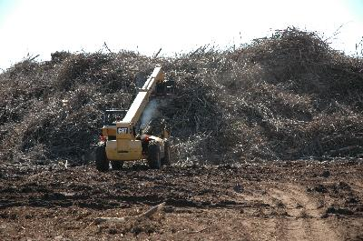
Ice storms pose particular falling debris hazards for responders
Republic, MO, 2-27-07. A loader on debris pile after an ice storm created two million cubic yards of debris.
FEMA Photo/Michael Raphael
Notes:
Trainers Notes:
Republic, MO, 2-27-07 -- A loader moves debris up a giant and growing pile of debris collected in Springfield and the rural area of Greene County around the city, where more than two million cubic yards of debris were generated by the ice storm Jan. 12-14, 2007.

